Slide 1
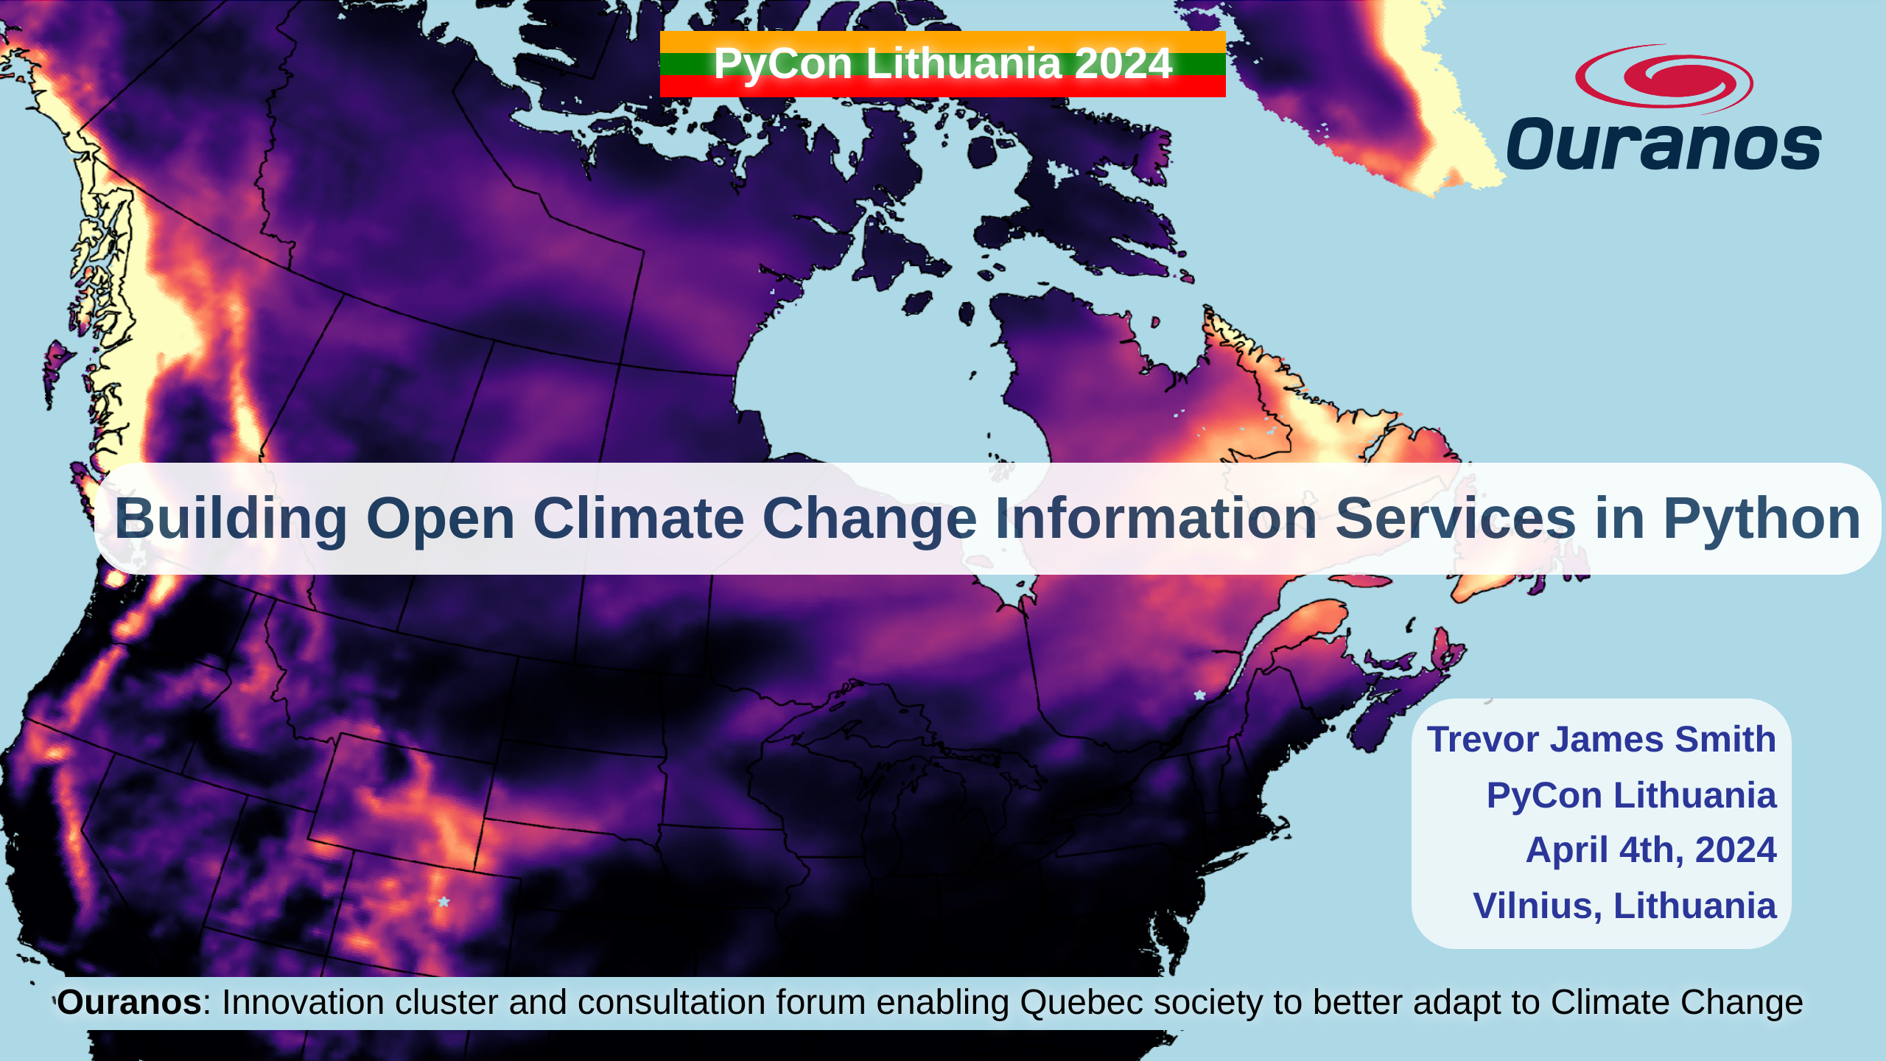
Notes:
Thanks so much to PyCon Lithuania and the organizers for this fantastic conference so far. Today, I’m talking about how we've been using Python to build our open source offerings to better equip researchers interested in climate science.

Slide 2
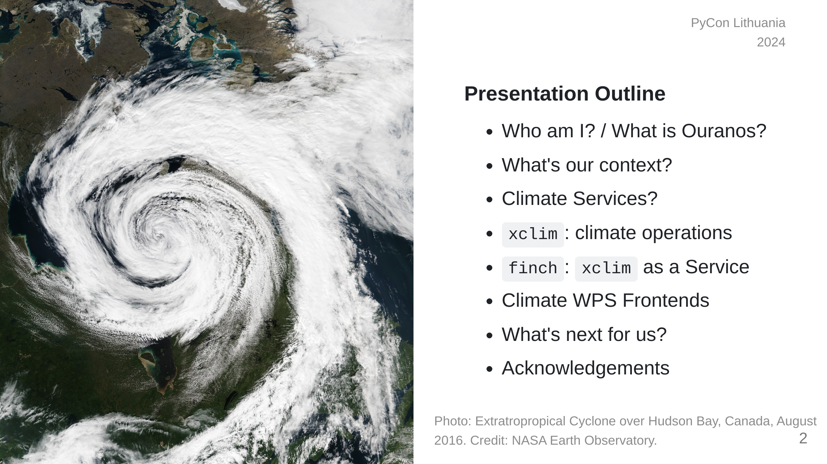
Notes:
This presentation is going to start by providing some context on climate adaptation information services, what my company has built with xclim and how we're actively making these kinds of analyses more accessible worldwide.

Slide 3

Notes:
So who am I? I'm a research software developer from Montréal, Québec. My background is in environmental science, specifically GIS and agroclimate modelling. I only really started picking up dev work on the job. I'm also learning Japanese for fun.

Slide 4
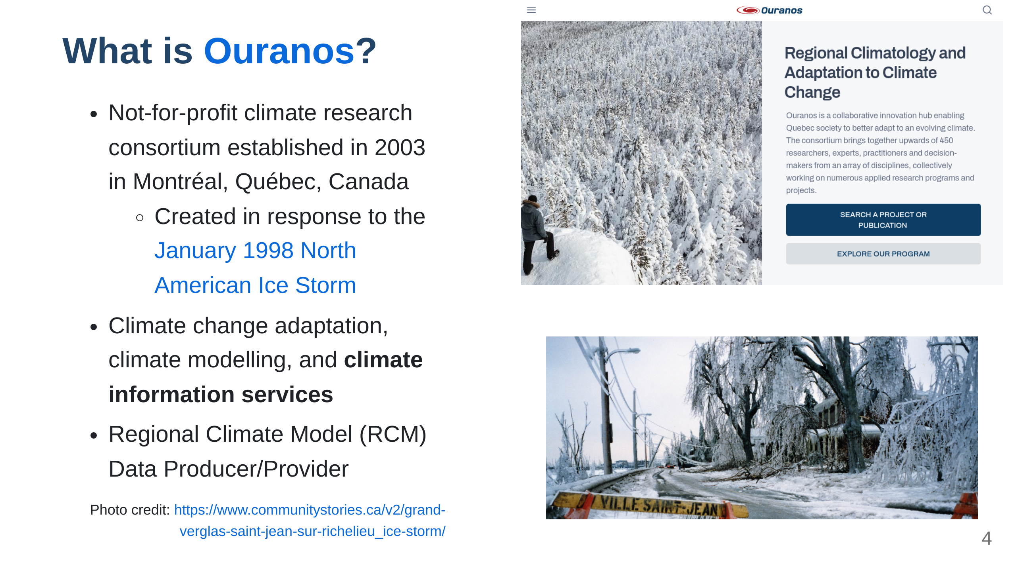
Notes:
My employer, Ouranos, is a not-for-profit based on Montréeal that works with the Canadian and Quebec governments on climate change adaptation. We were created in response to an extreme storm event that had 1.5 Million people without power for weeks and caused around 5.5 Billion dollars in damage. Our role is to connect government, industry, and academia with many types of climate information so that events like those are less impactful. For the past 8 years or so, we've been moving into software and research platform development. The core development team is small, but we do a lot of collaboration.

Slide 5
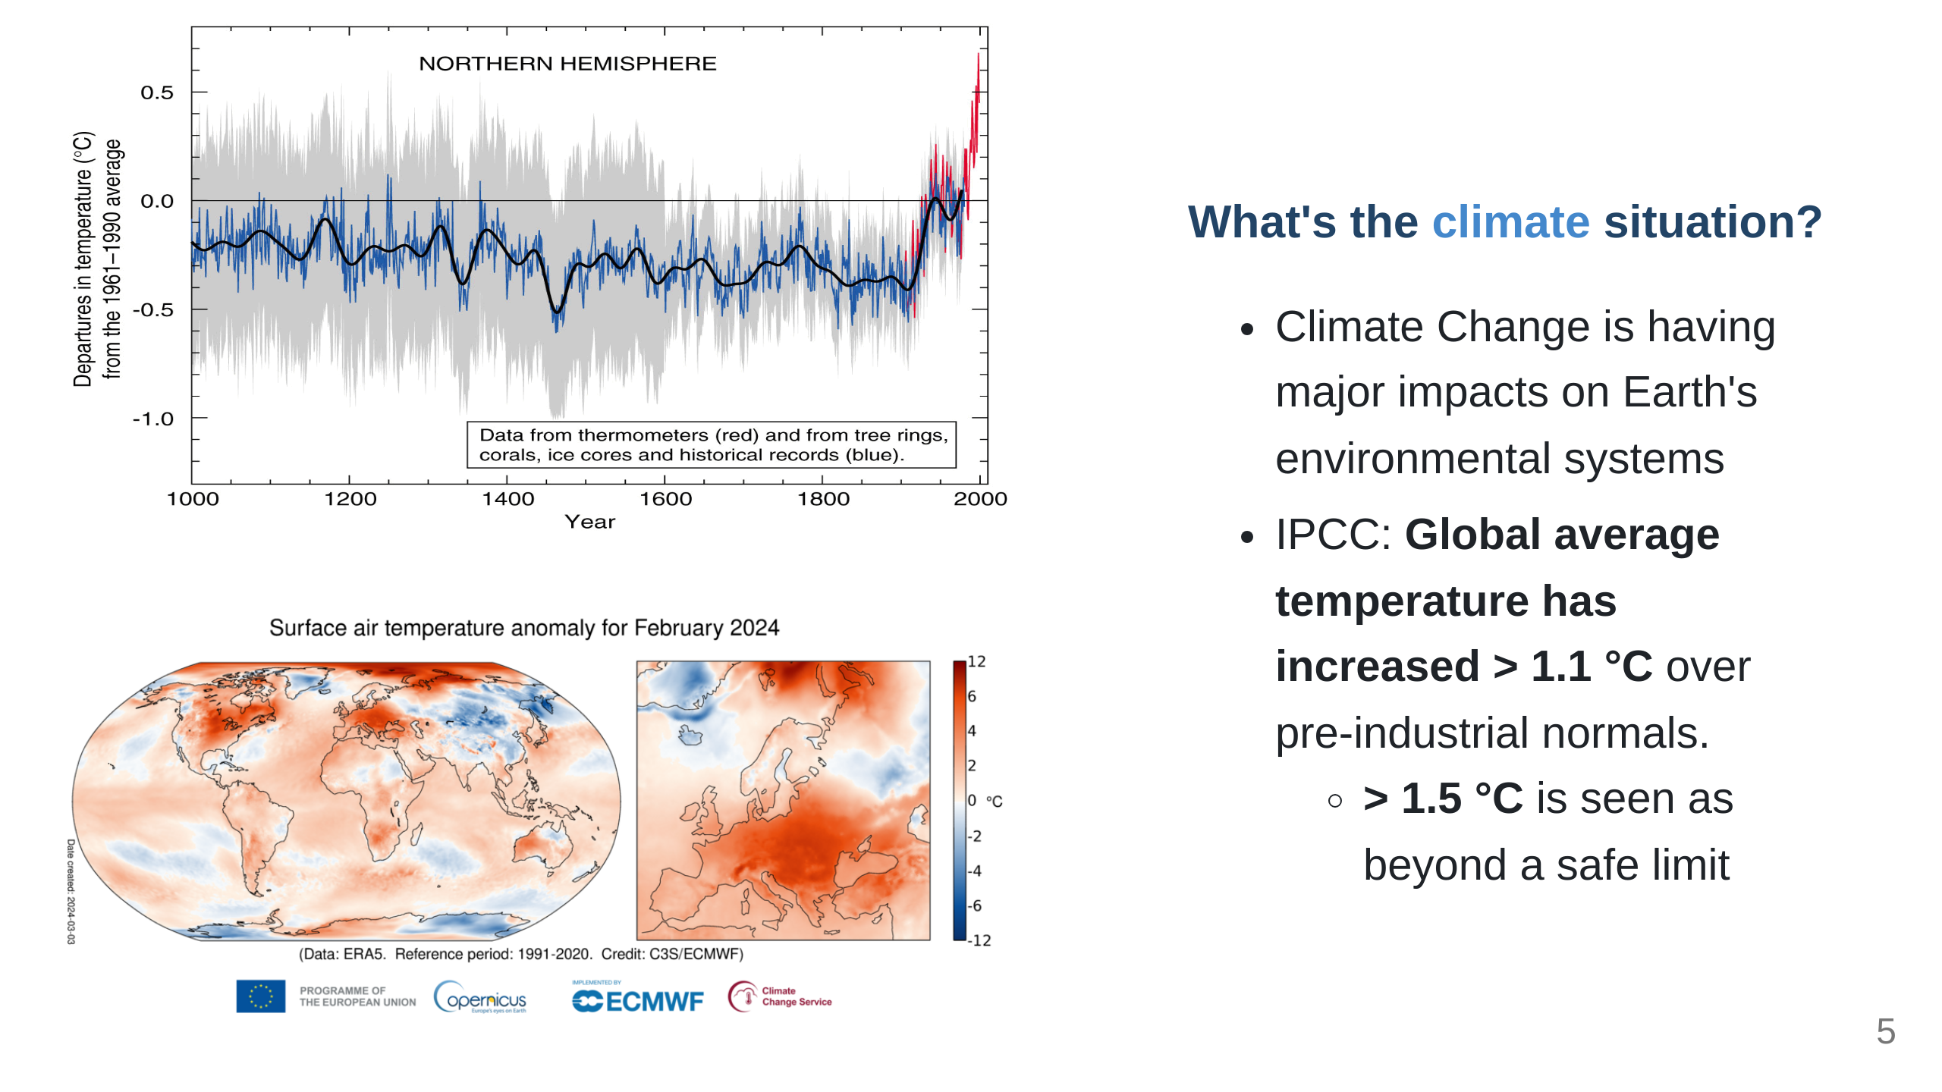
Notes:
Before we get to the Python, it would be good to talk about why climate researchers are becoming software developers; The fact that human-induced Climate Change is occurring is established fact. The temperature change alone has the potential to really impact a lot of things we depend on. Extreme global weather patterns are just one such side effect. *"Since systematic scientific assessments began in the 1970s, the influence of human activities on the warming of the climate system has evolved from theory to established fact"* \- IPCC Sixth Assessment Report Technical Summary (IPCC AR6-TS)

Slide 6
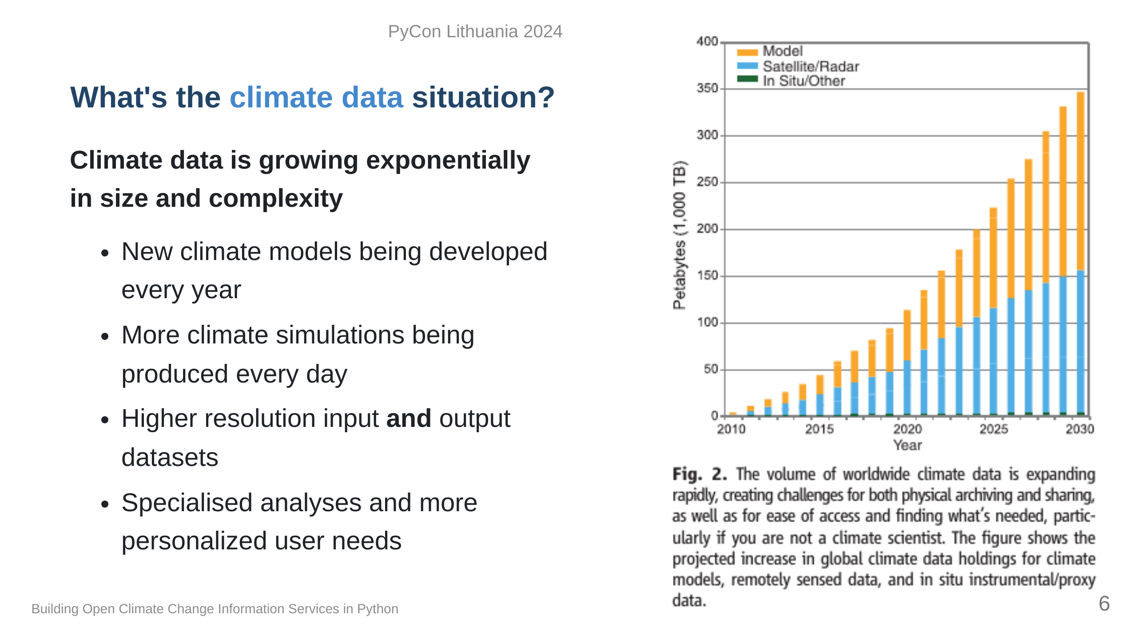
Notes:
Since we only have one Earth to run experiments on, climate models are one tool to give us physically consistent estimates on what the future _could_ look like. Unfortunately, this means we need more and more storage and computation resources to test more hypotheses. At some point it becomes completely unmanageable and really challenging to even use it, so we need intermediaries to help. "Overpeck, Jonathan T., Gerald A. Meehl, Sandrine Bony, and David R. Easterling. “Climate Data Challenges in the 21st Century.” Science 331, no. 6018 (February 11, 2011): 700–702. https://doi.org/10.1126/science.1197869"

Slide 7
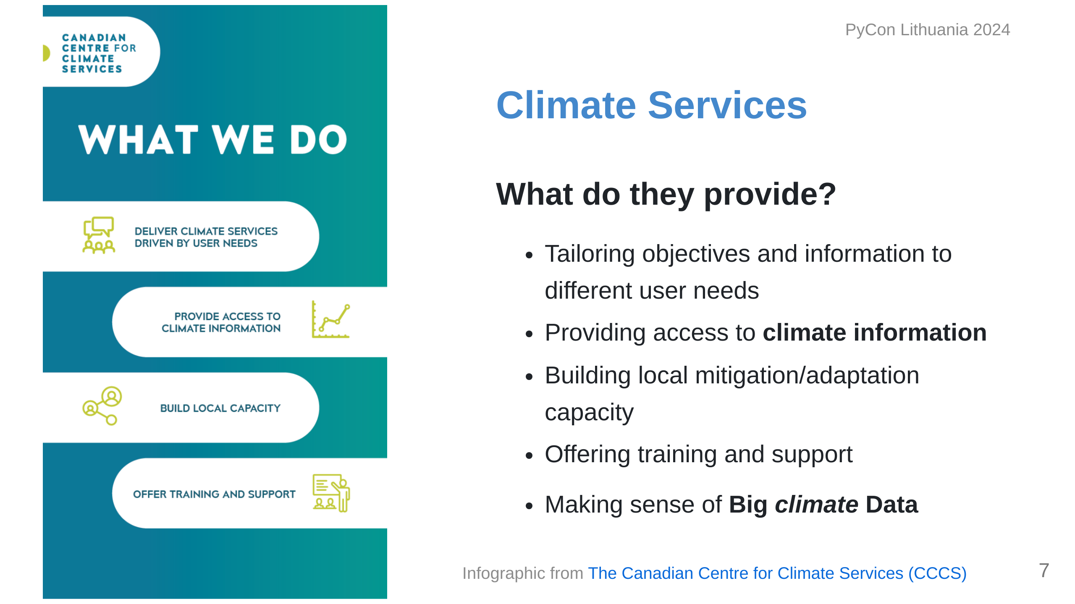

Slide 8
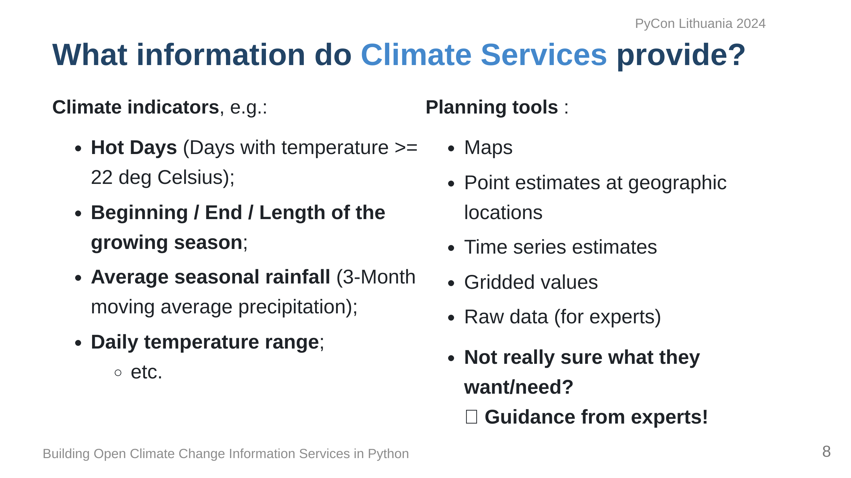

Slide 9
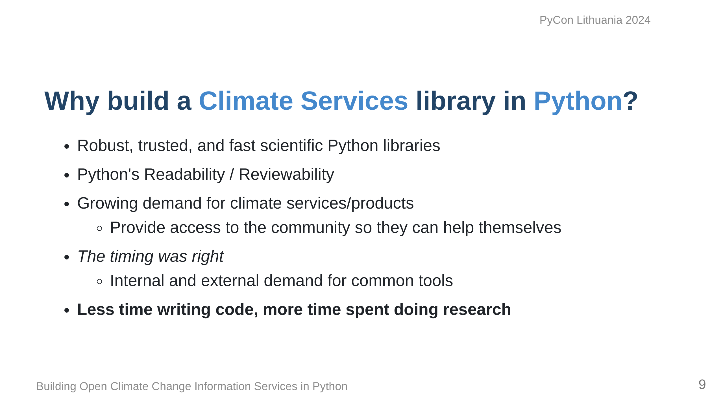

Slide 10
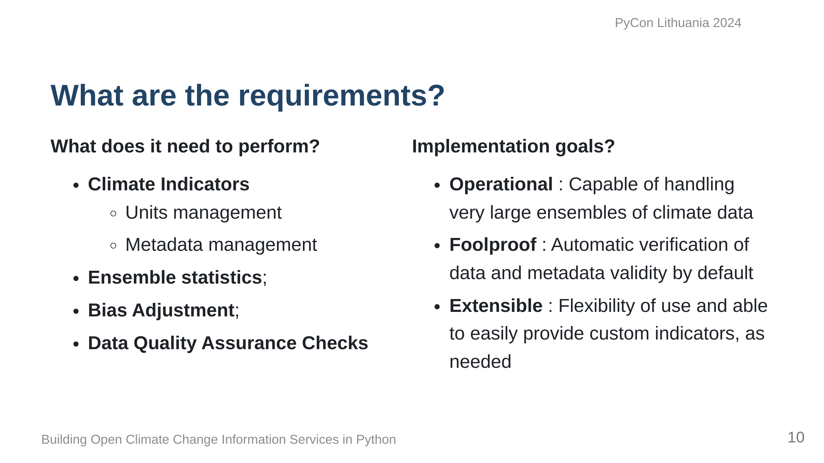

Slide 11
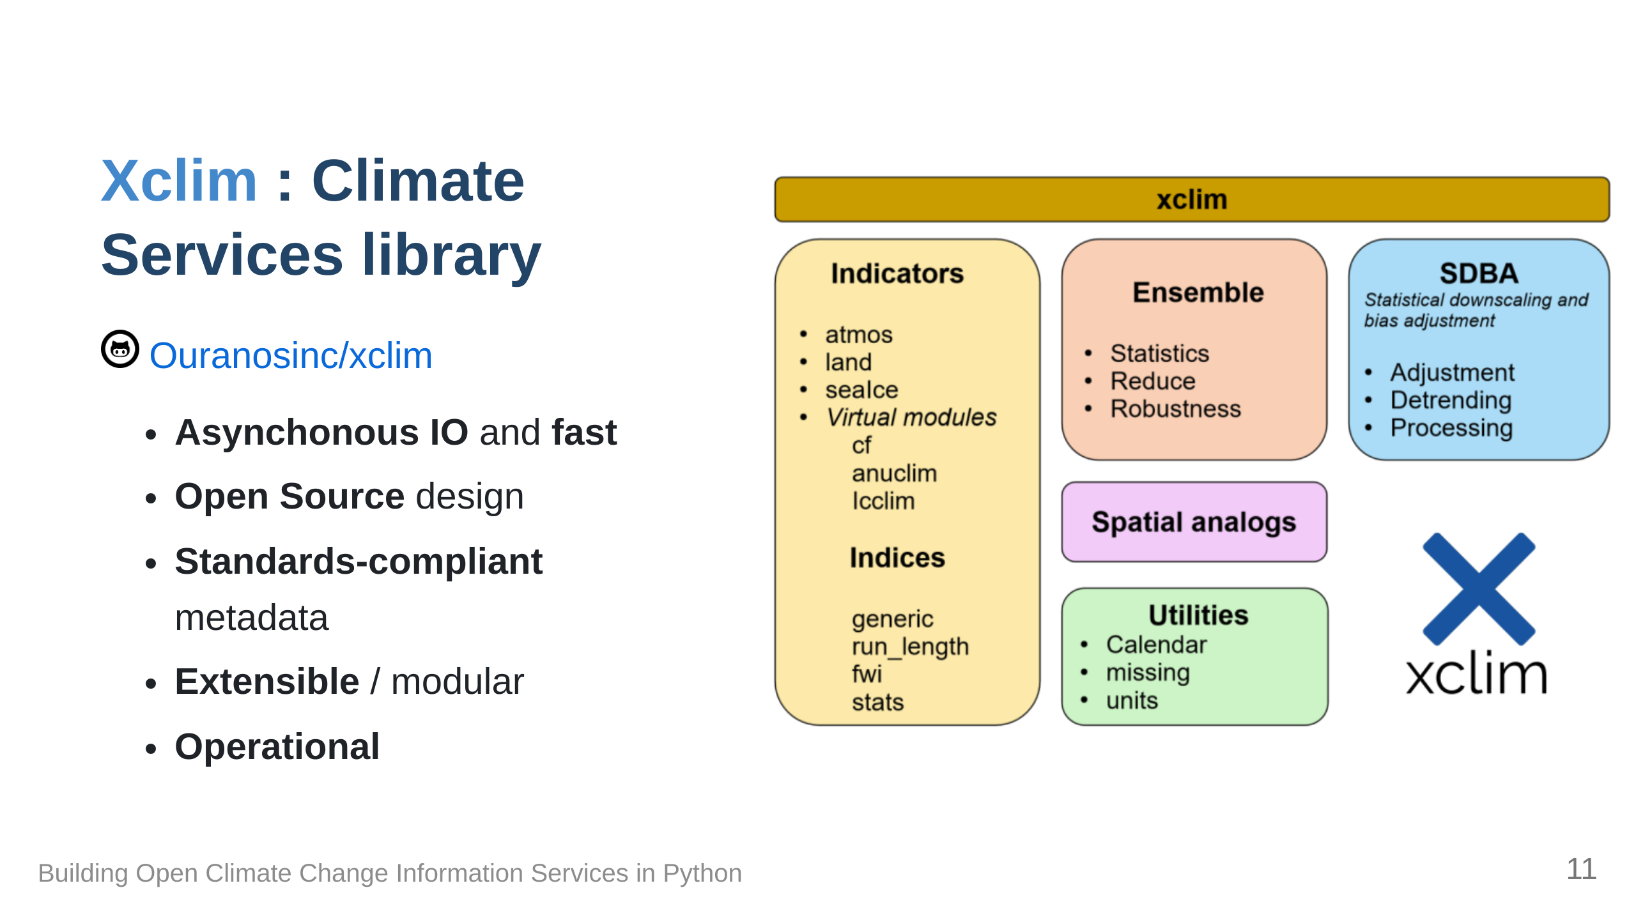

Slide 12
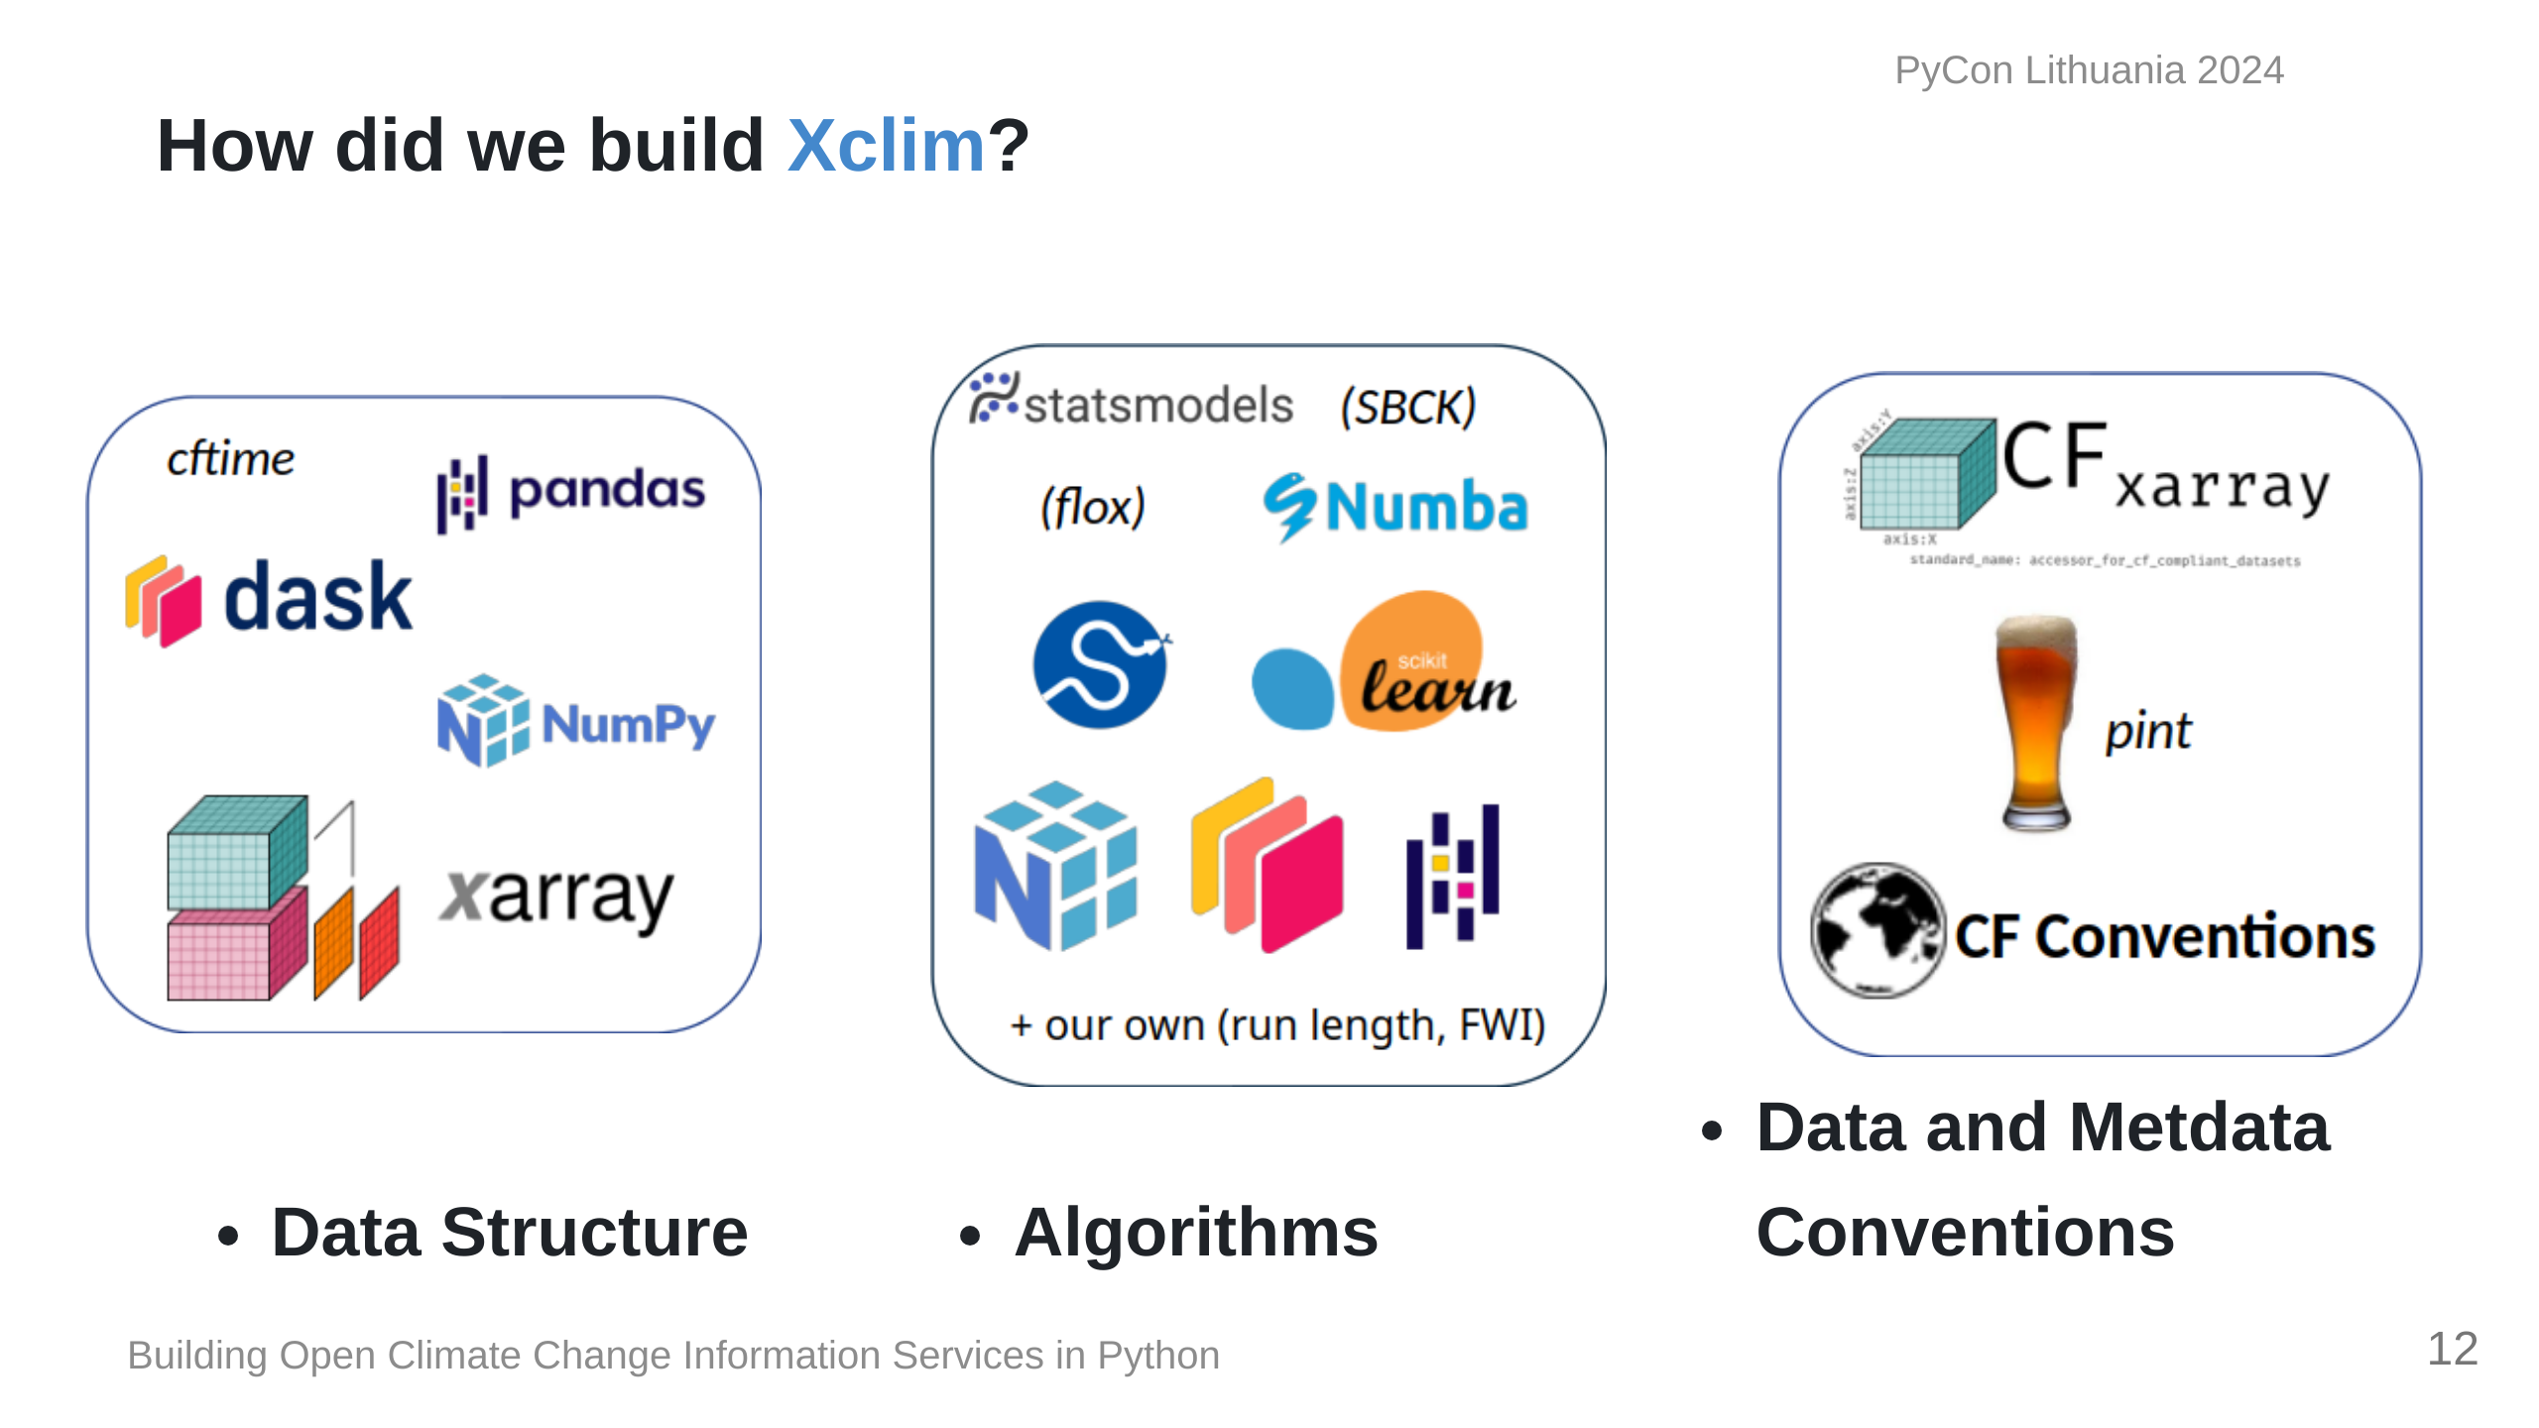
Notes:
We based our data structures on several Open Source scientific Python libraries, namely, Pandas, Numpy and Xarray, ensuring that our code can benefit from the parallelization made possible by Dask. Xclim was built to be an operational library and as such, we built our algorithms based on more conventional libraries such as scipy for statistics, scikit-learn for bias-adjustment. Numba provides Just-in-time compilation and Units management and conventions are also key to ensuring that the outputs of operations can be easily used in other applications, and issues such as unit management are handled via libraries dedicated to ensuring that dimensions are always preserved and expected output units are always the same, regardless of inputs.

Slide 13
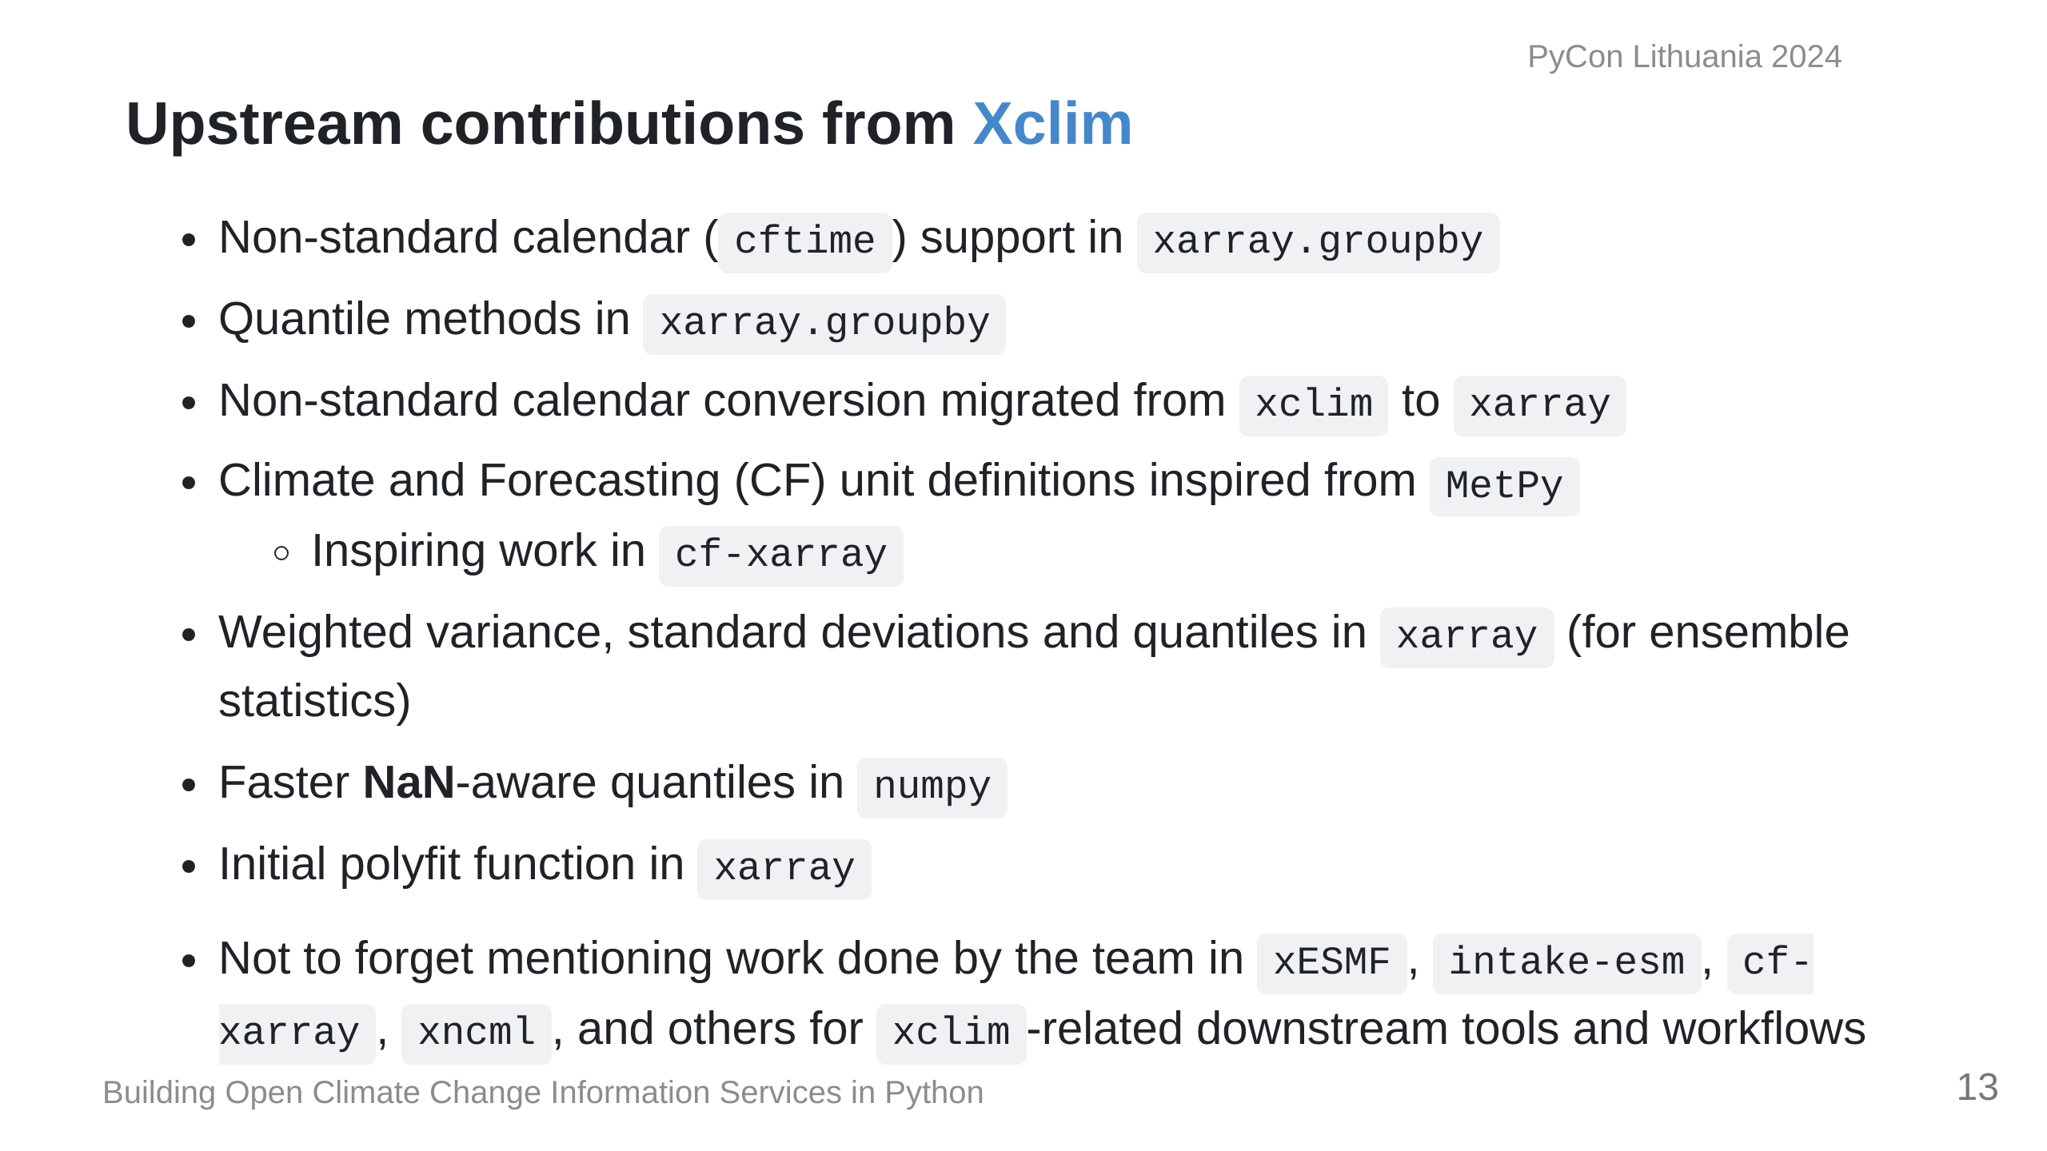

Slide 14
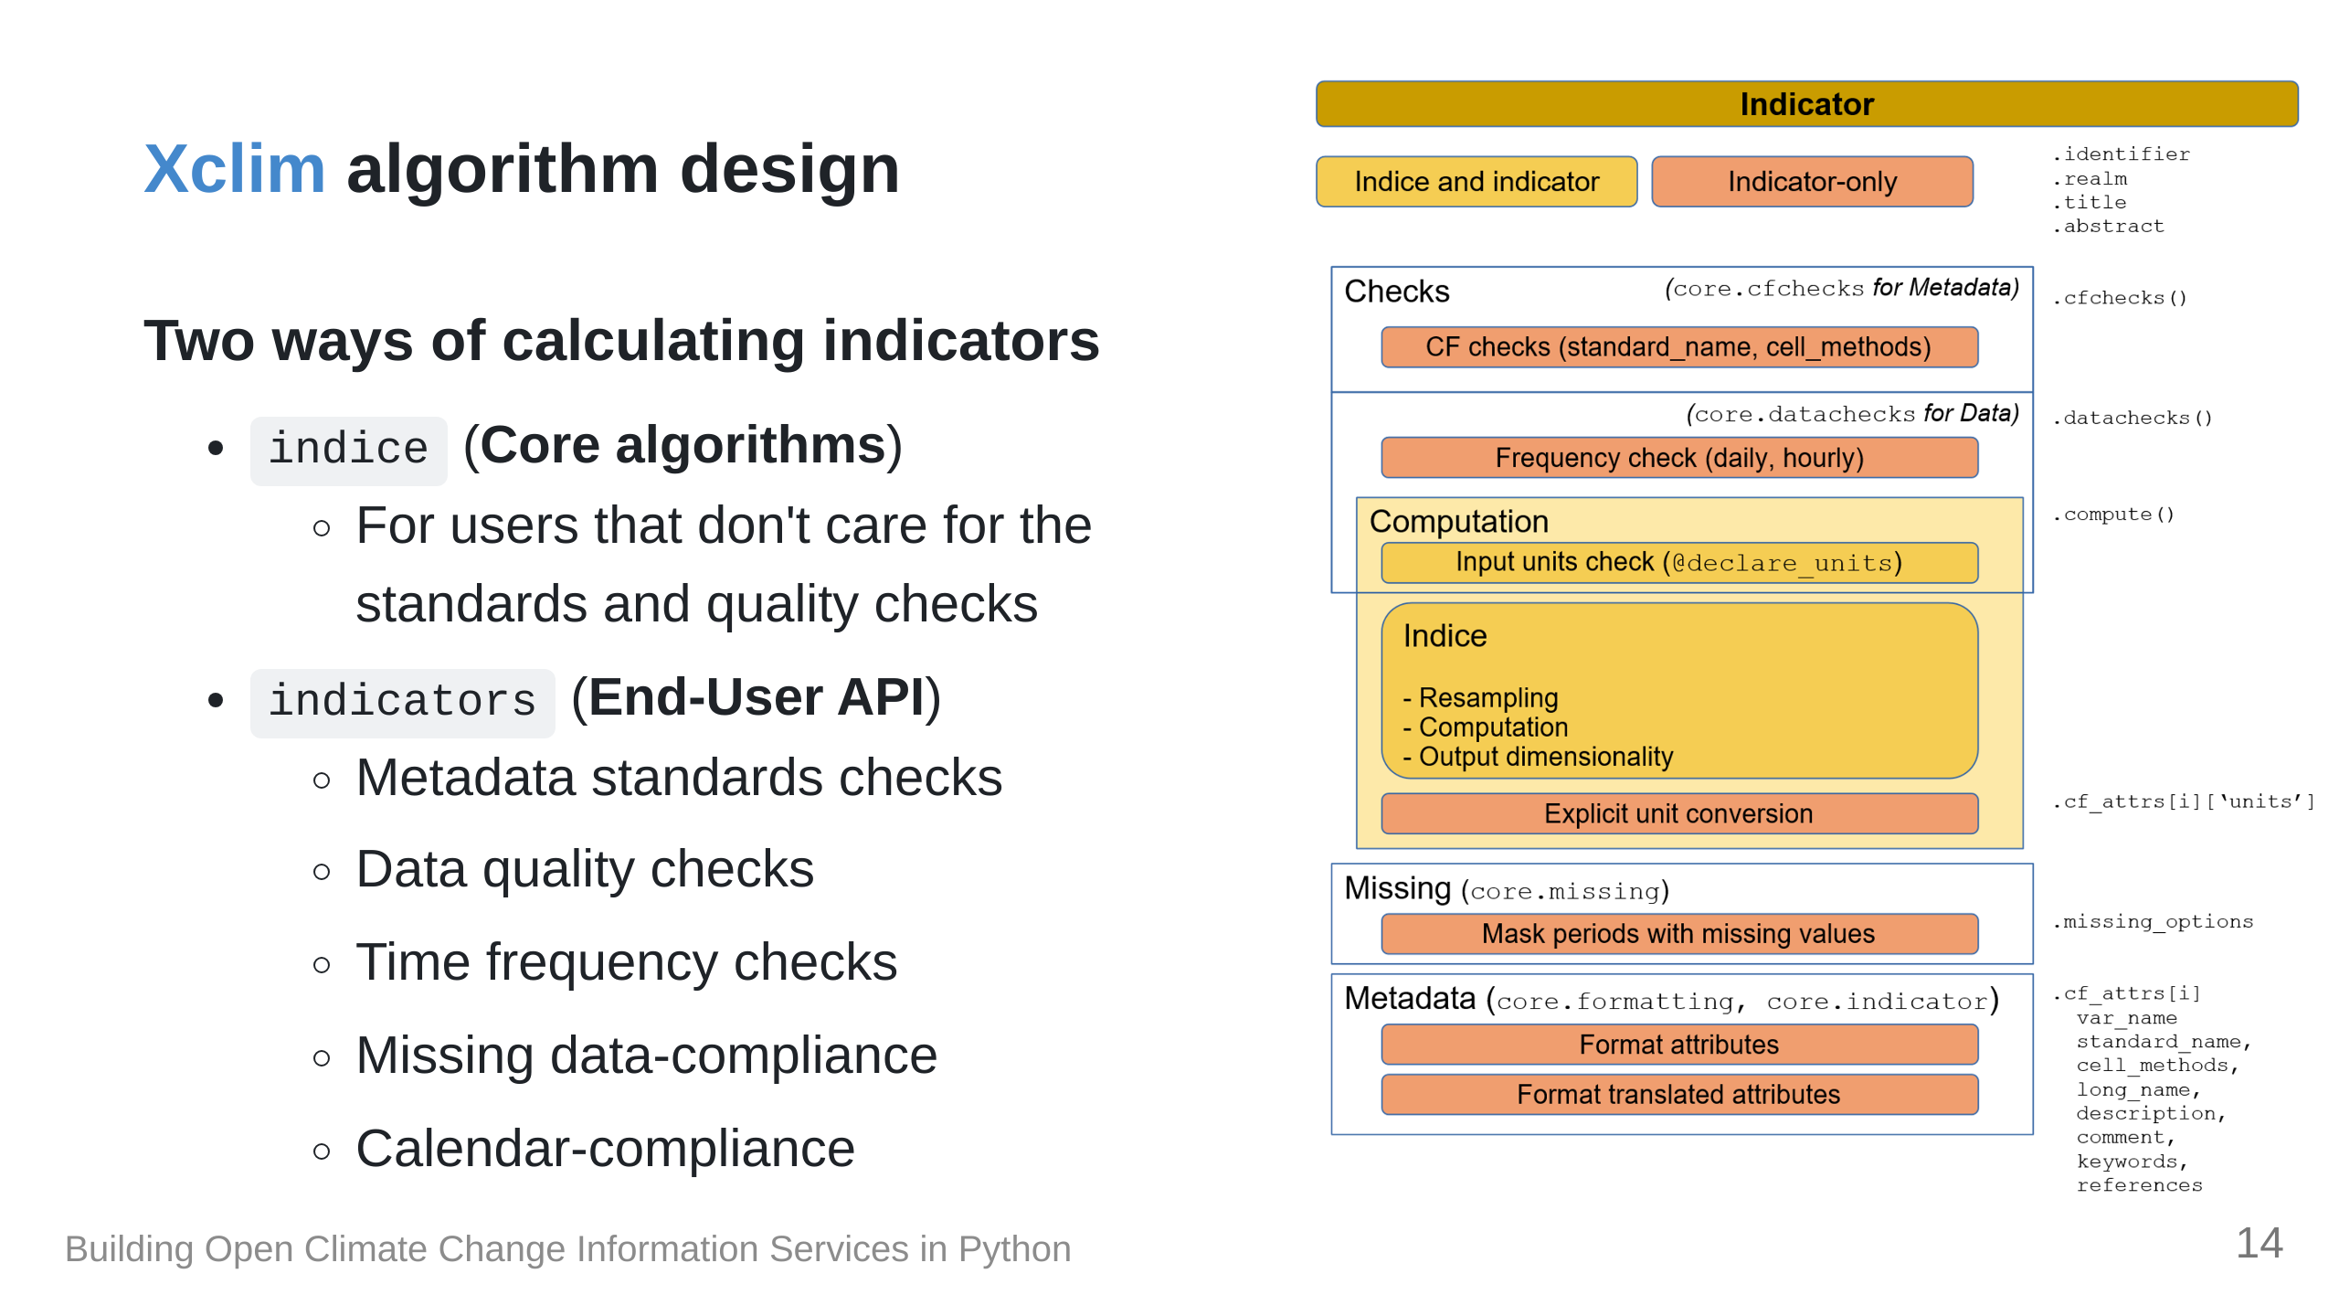

Slide 15
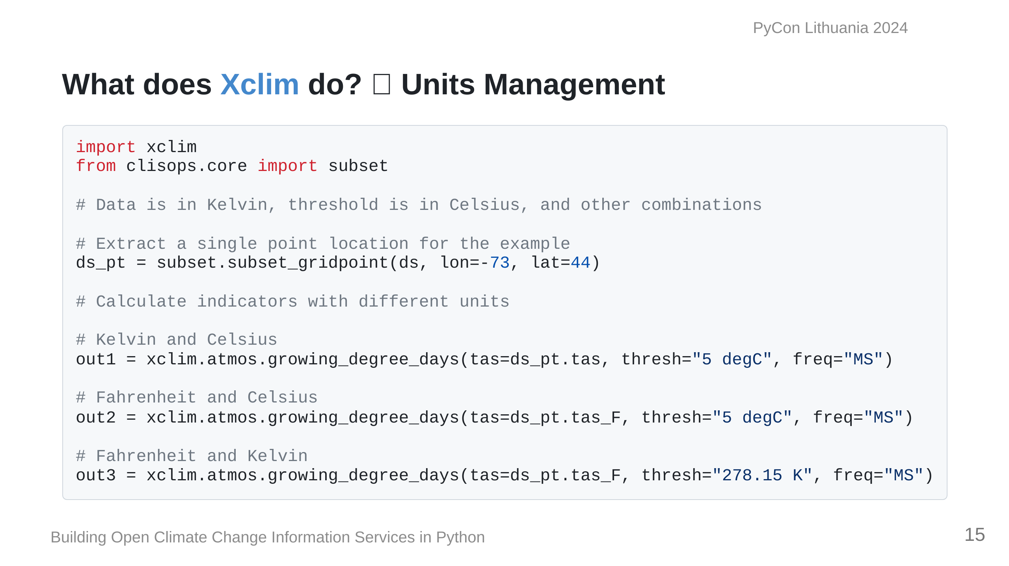

Slide 16
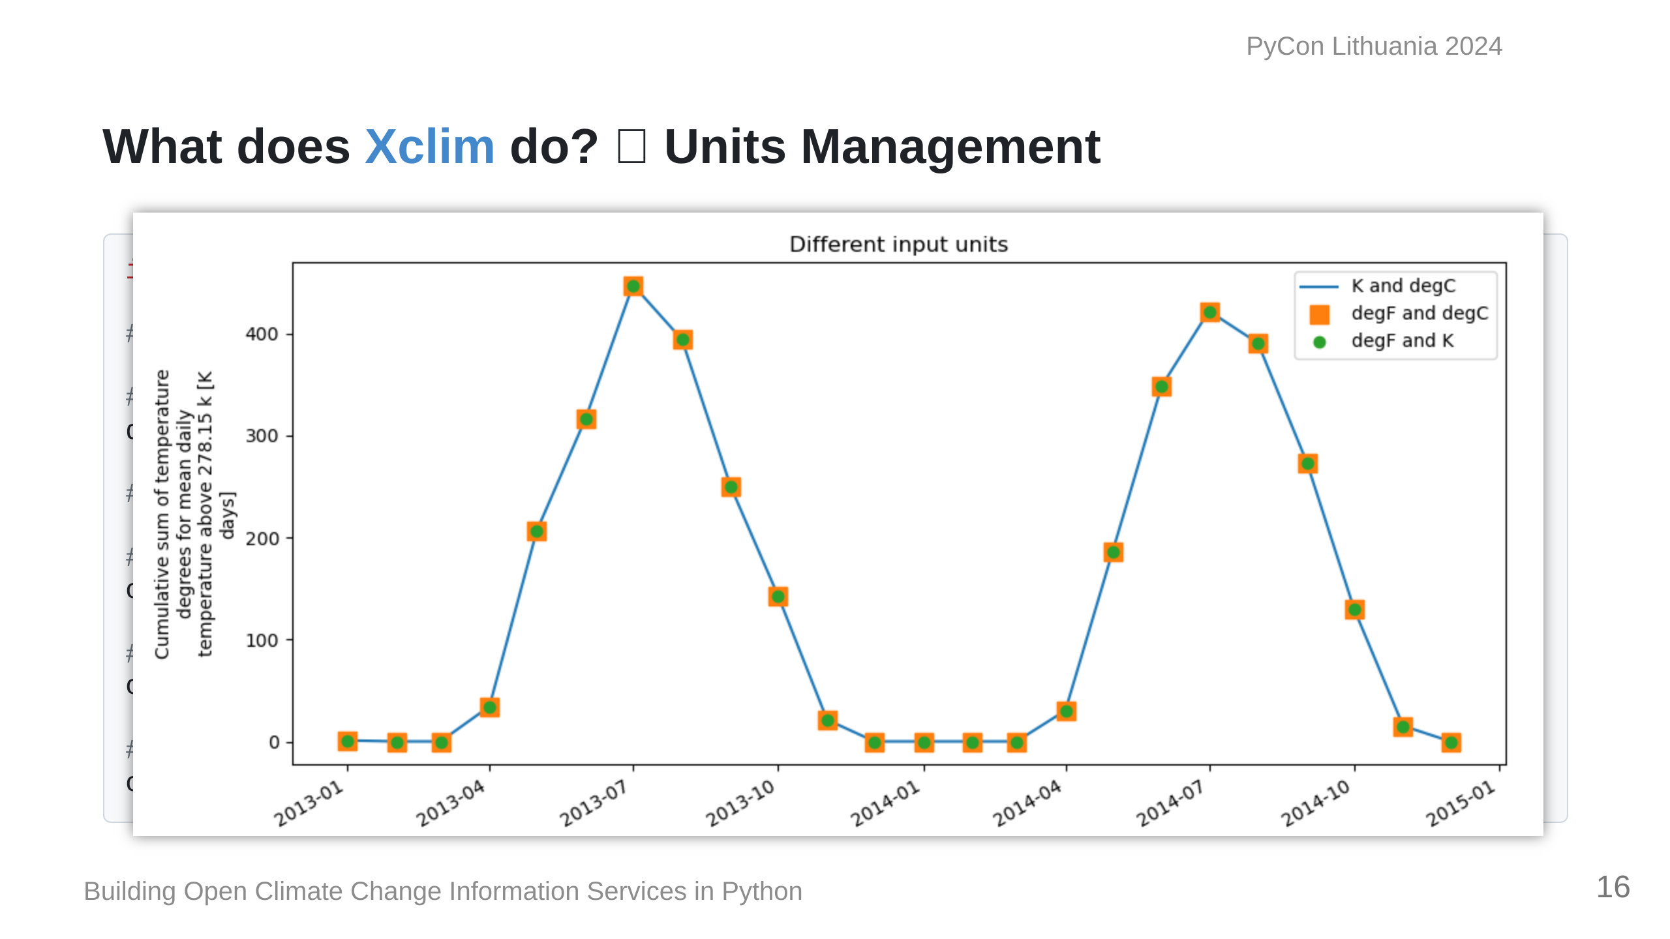

Slide 17
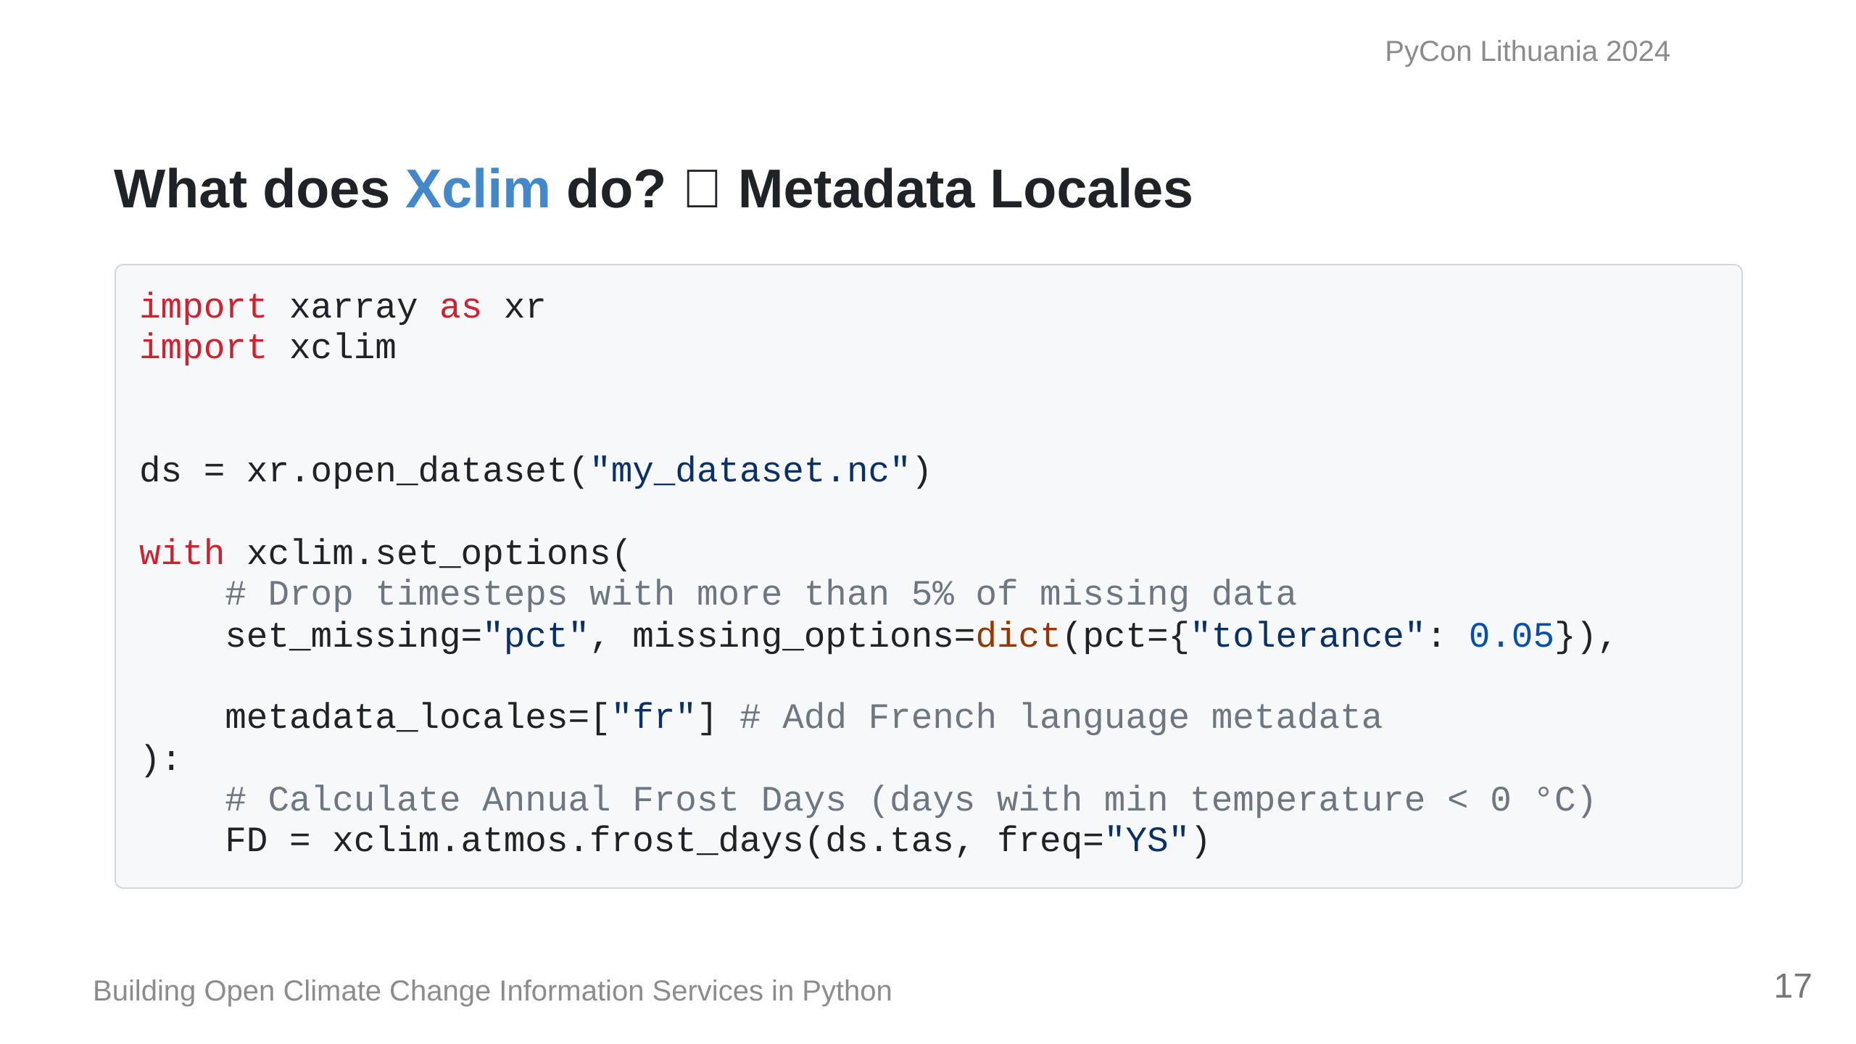
Notes:
`xclim` also has the ability to

Slide 18
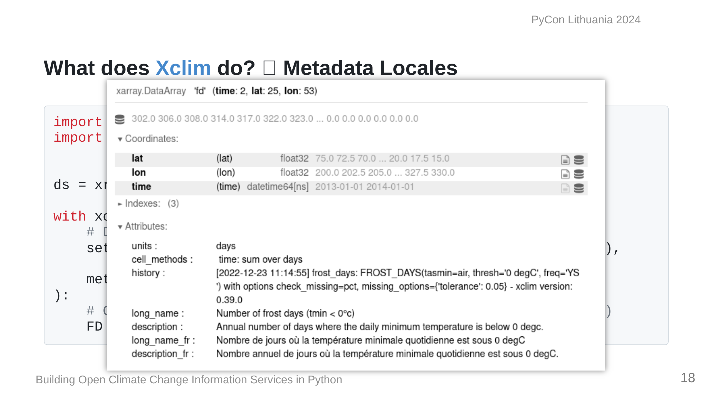

Slide 19
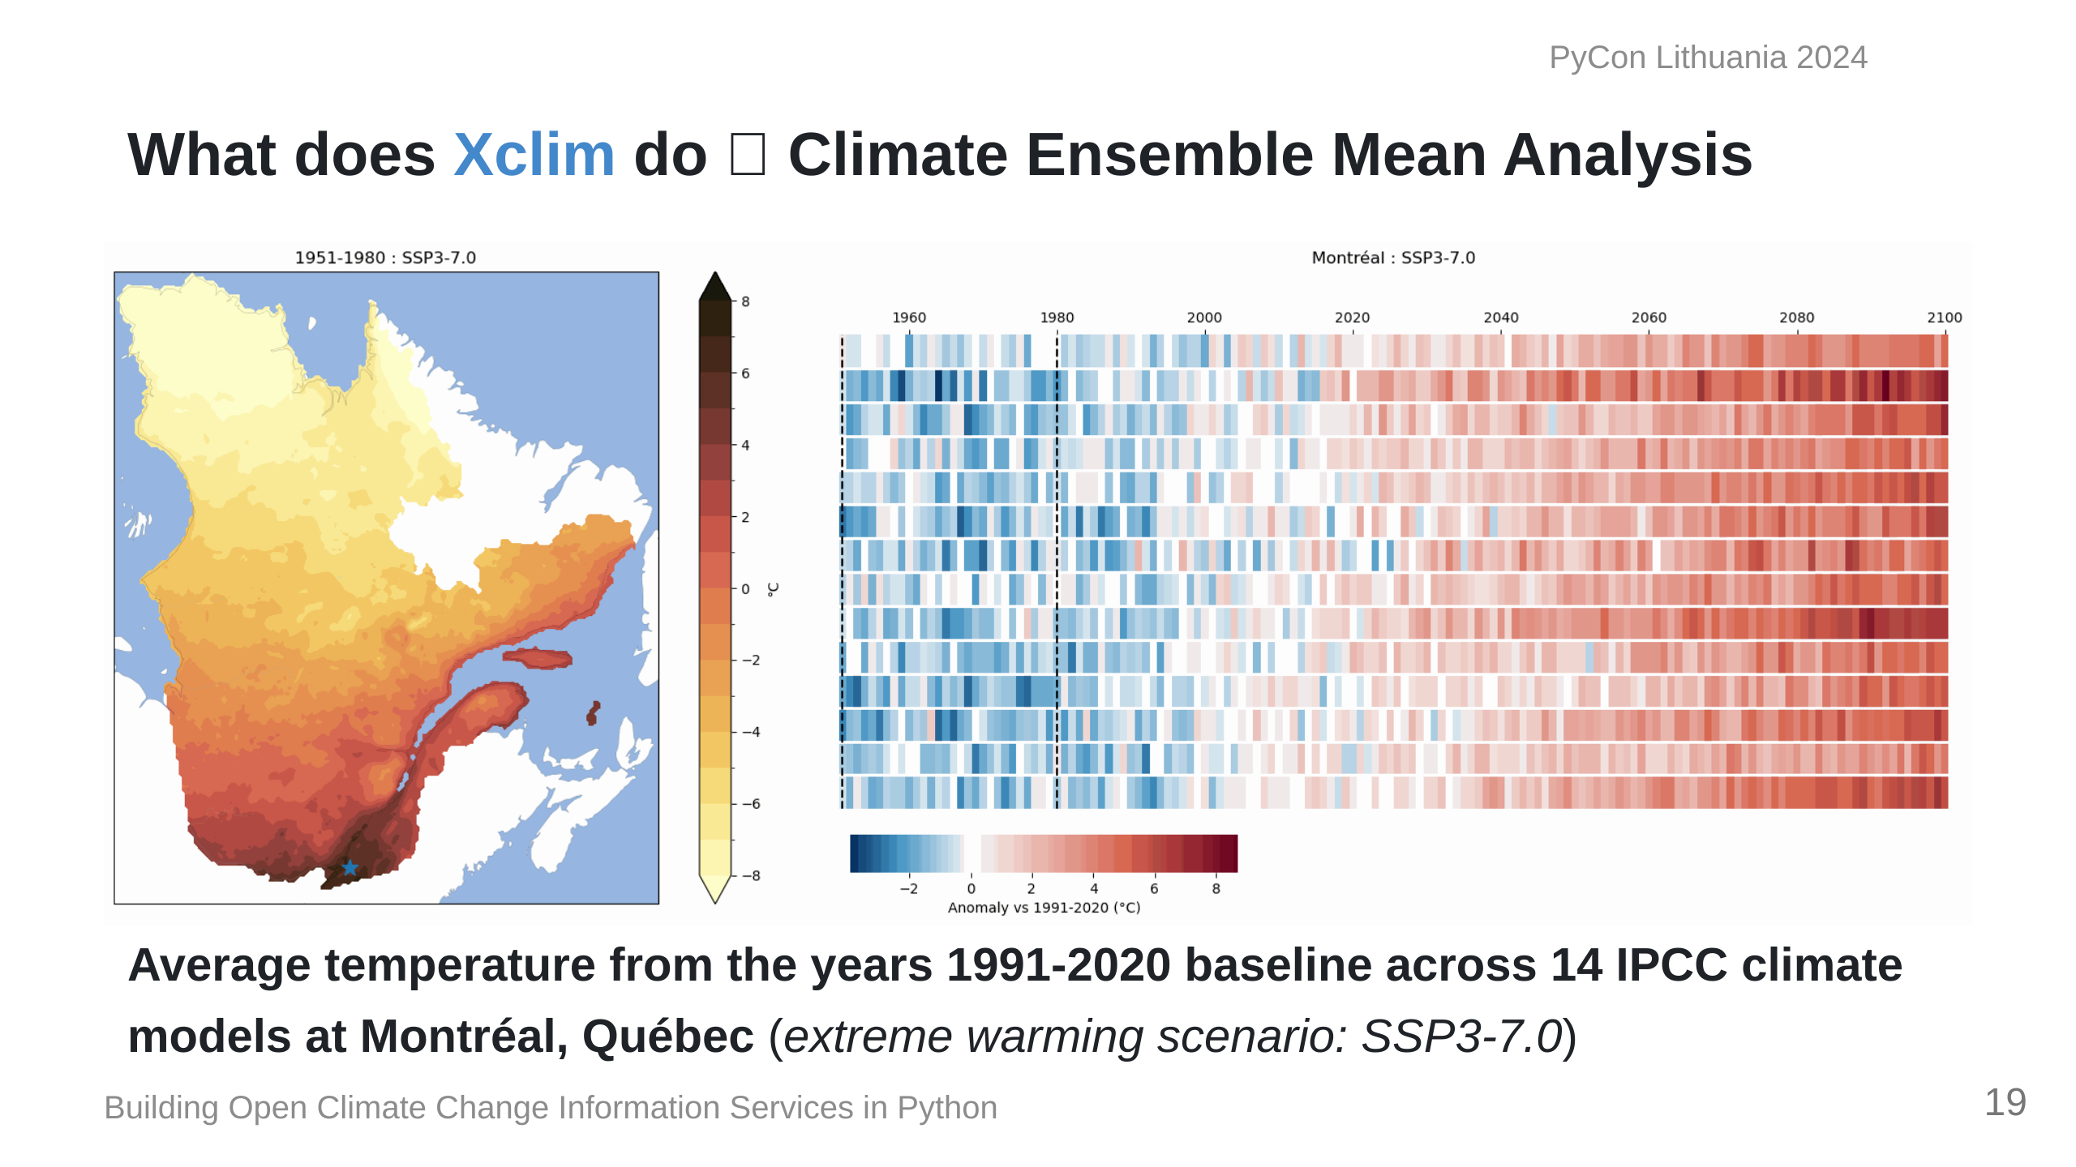
Notes:
This is an example of what we can calculate with `Xclim`; Here we have data from 14 climate models. On the left is the average annual temperature for the province of Quebec, while on the right is the average change from a 1990-2020 baseline across the 14 models.

Slide 20
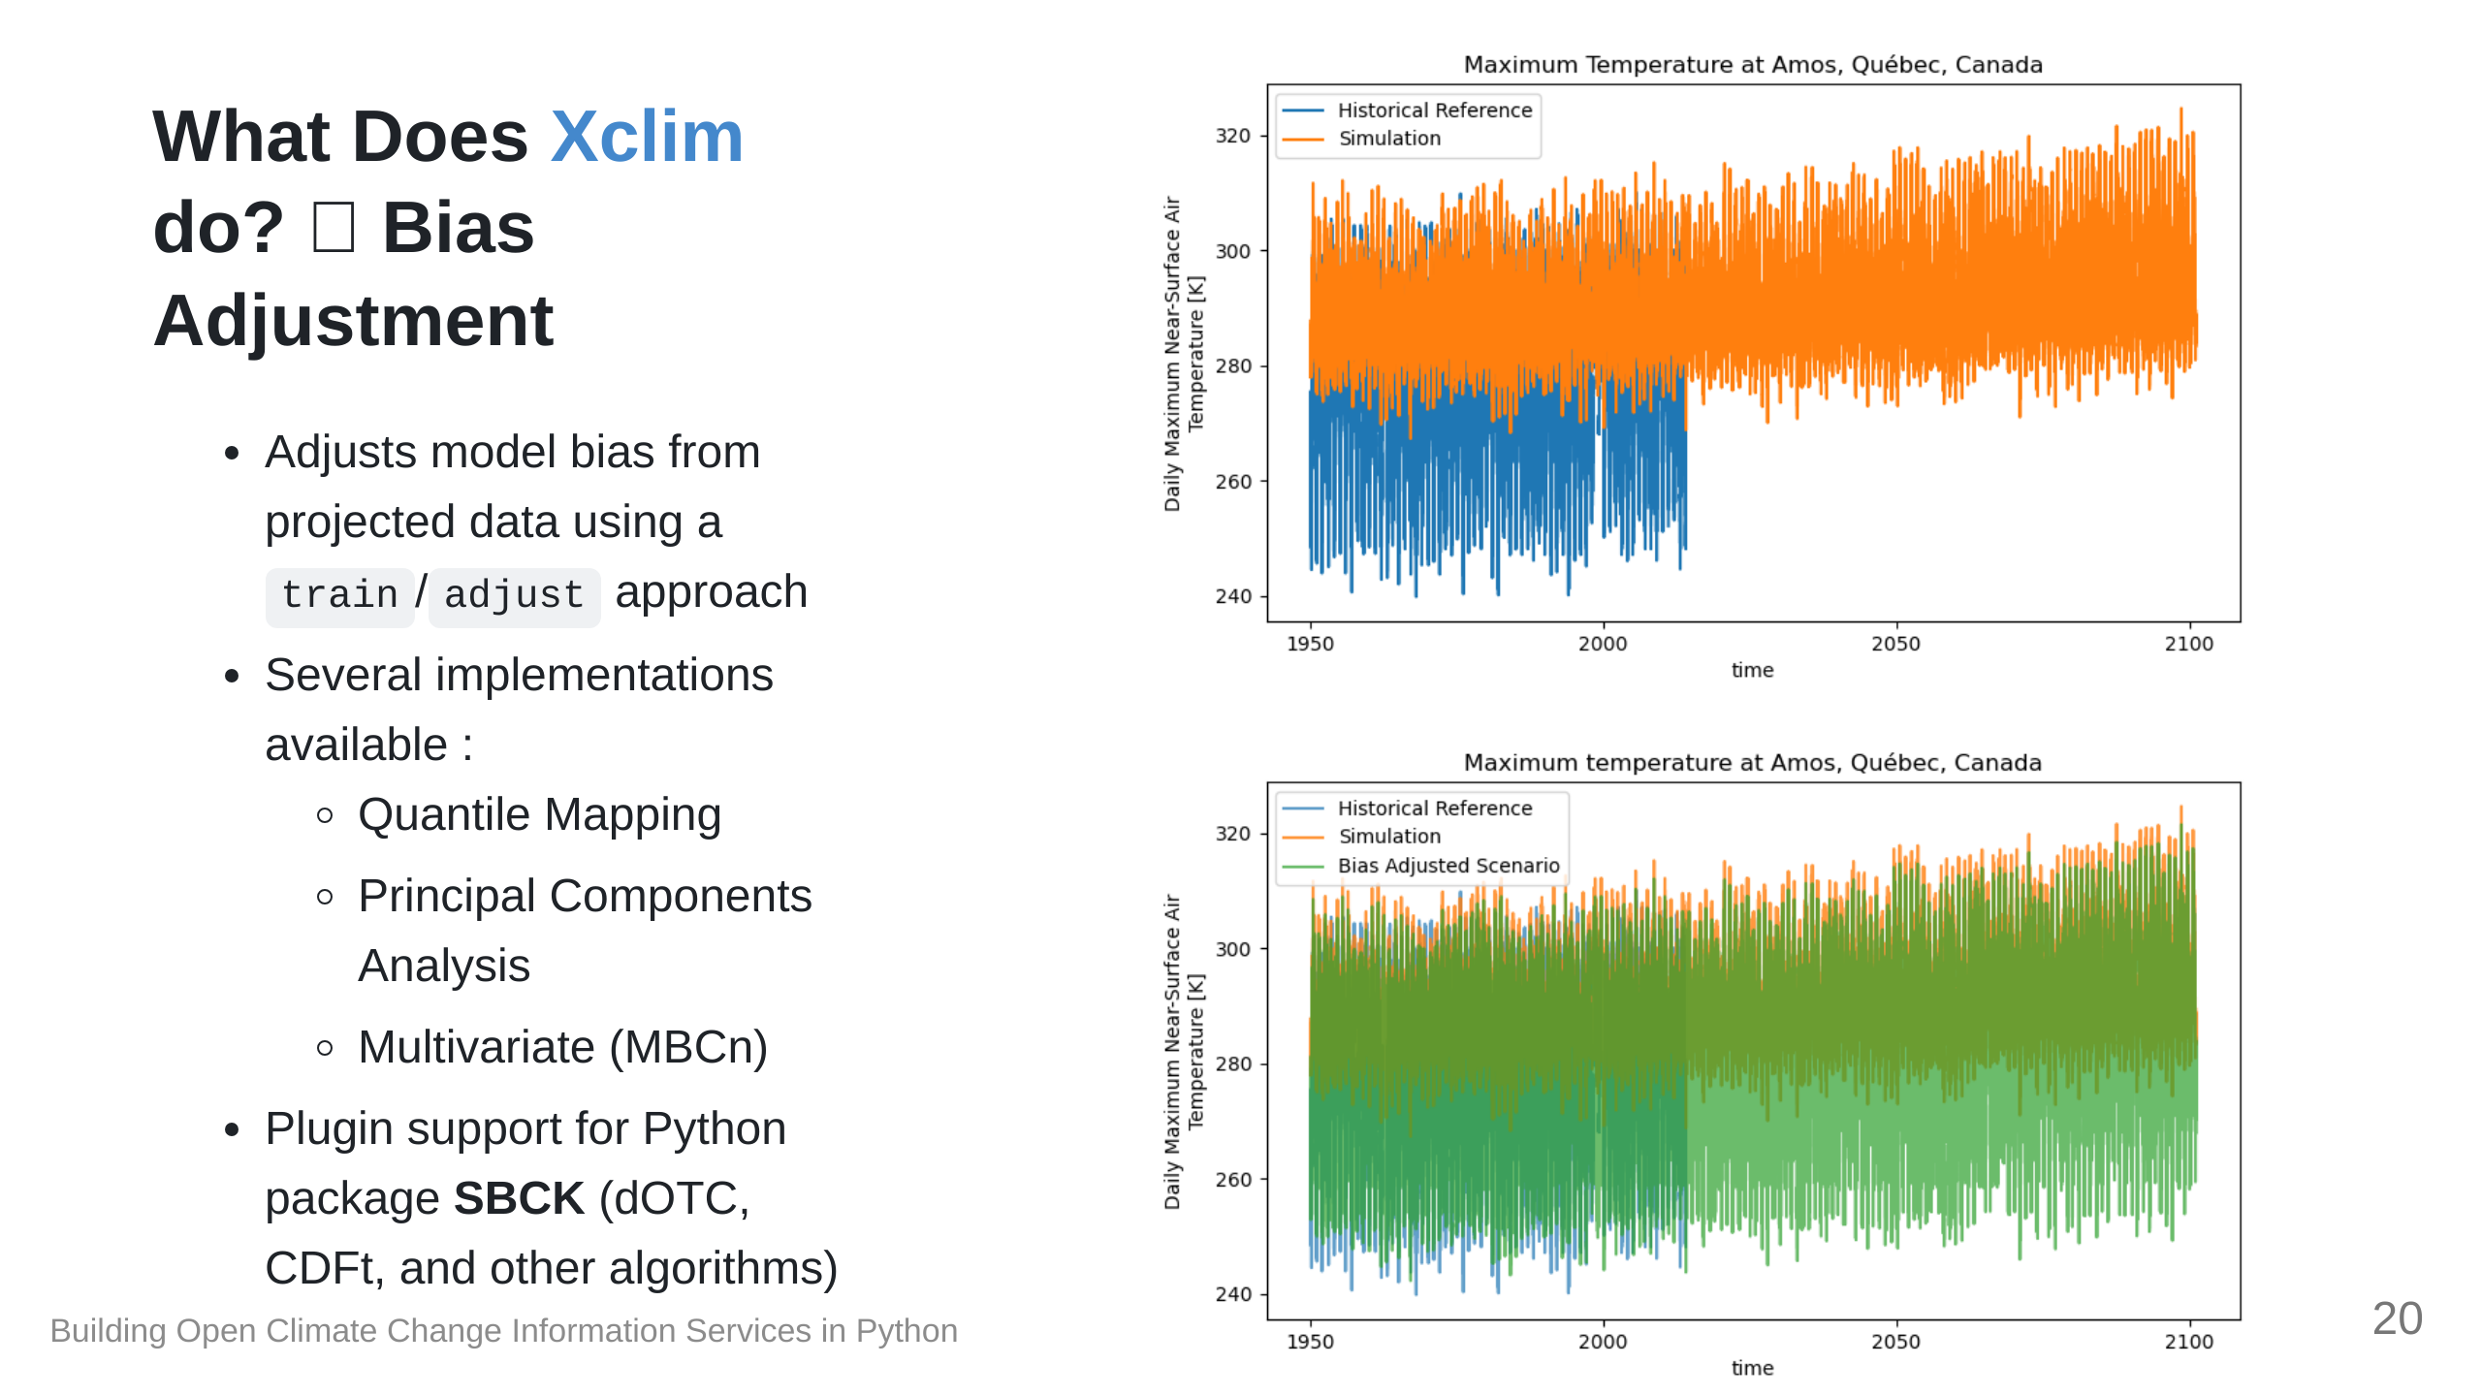

Slide 21
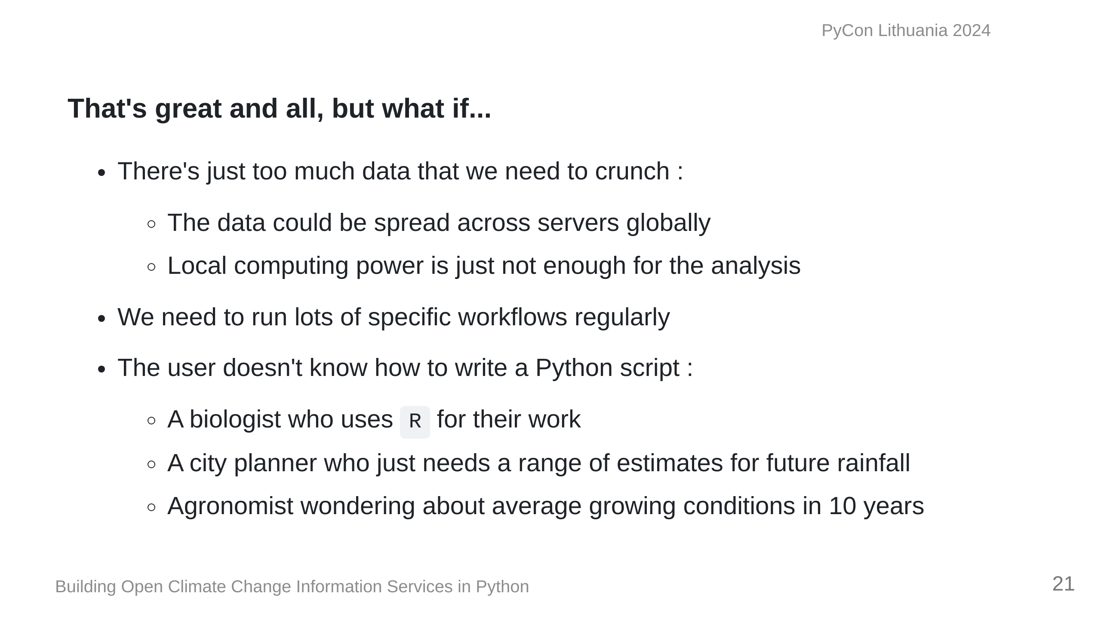

Slide 22
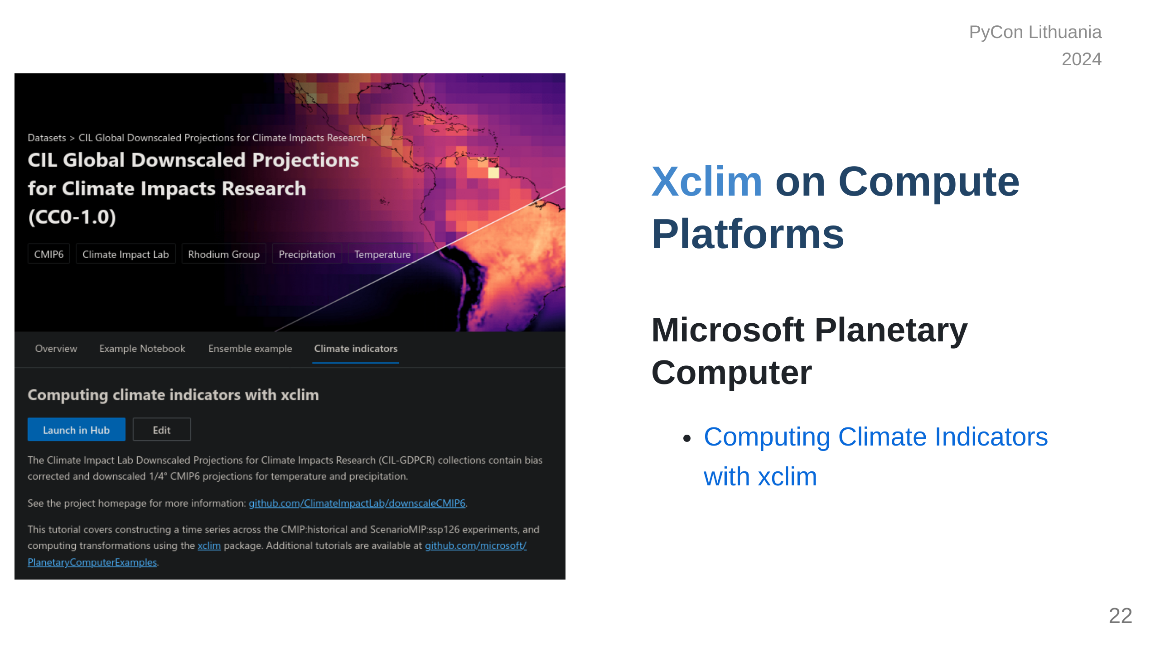

Slide 23
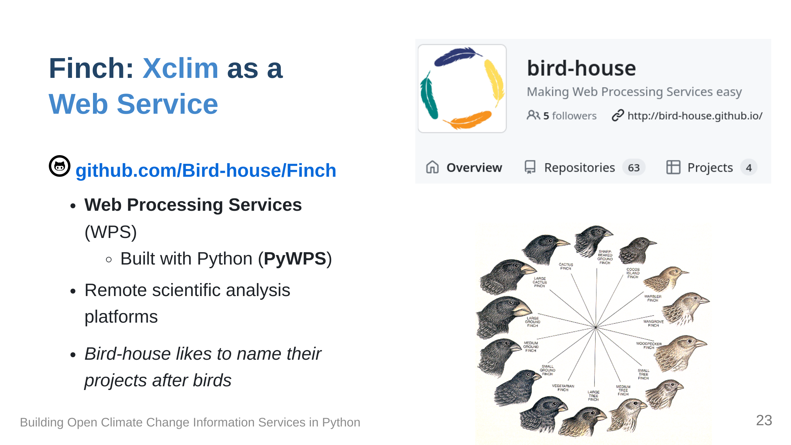

Slide 24
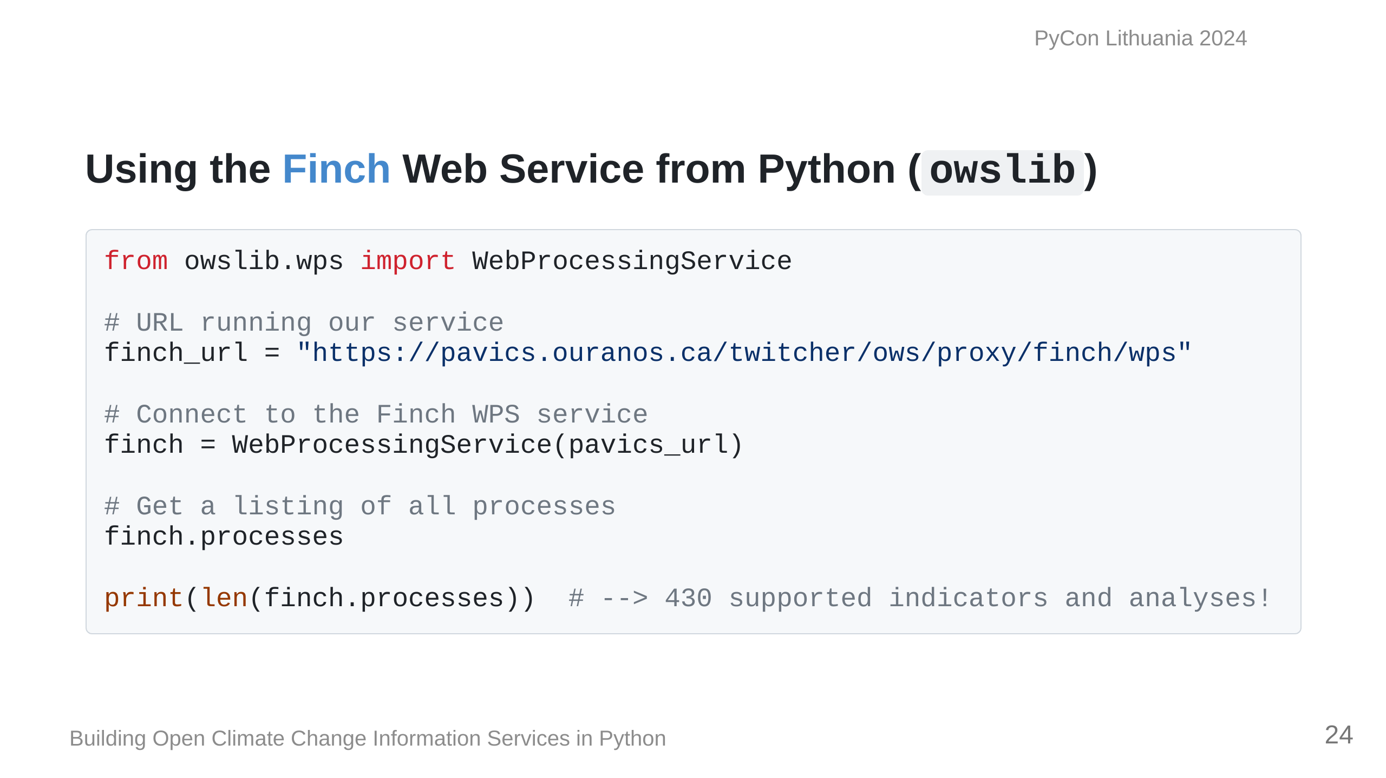

Slide 25
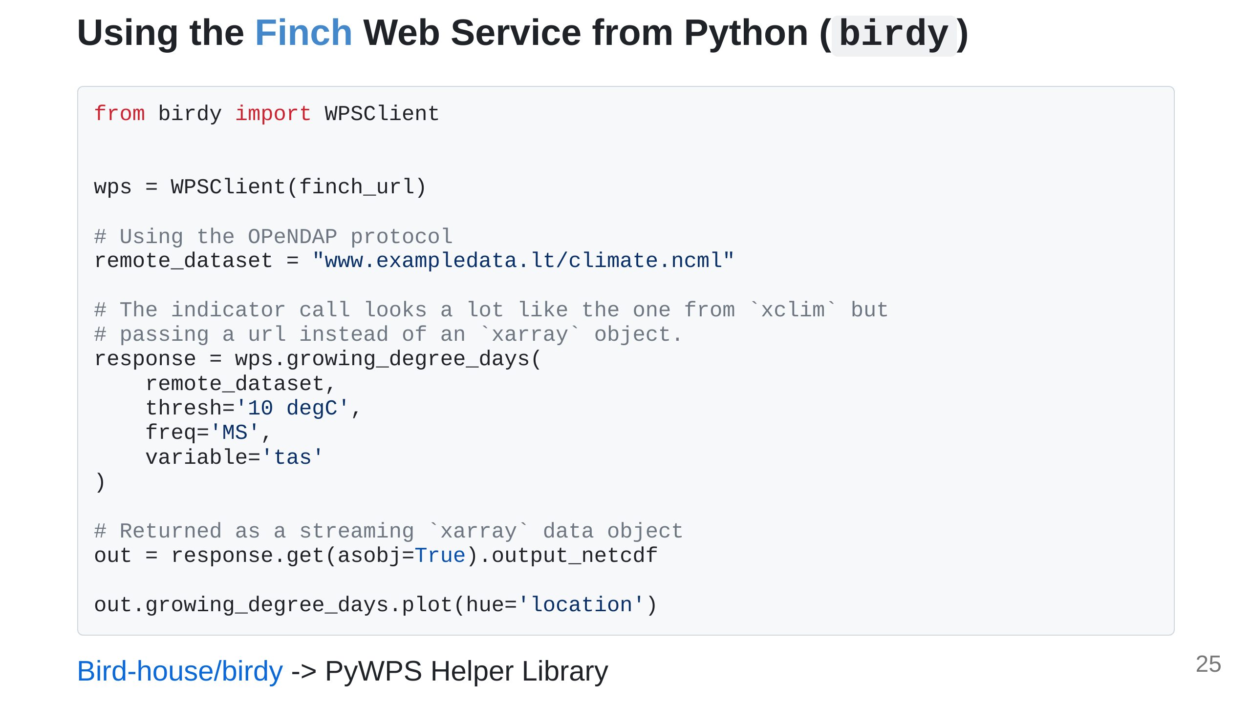

Slide 26
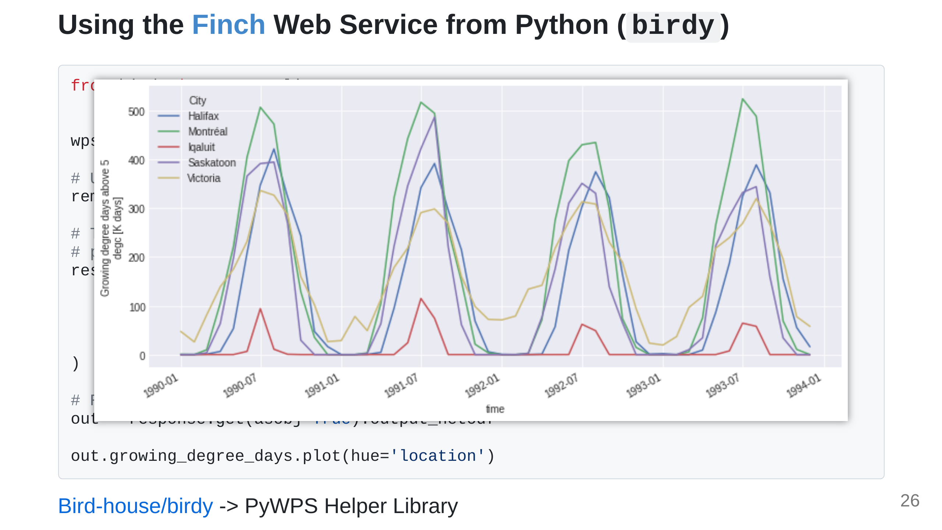

Slide 27
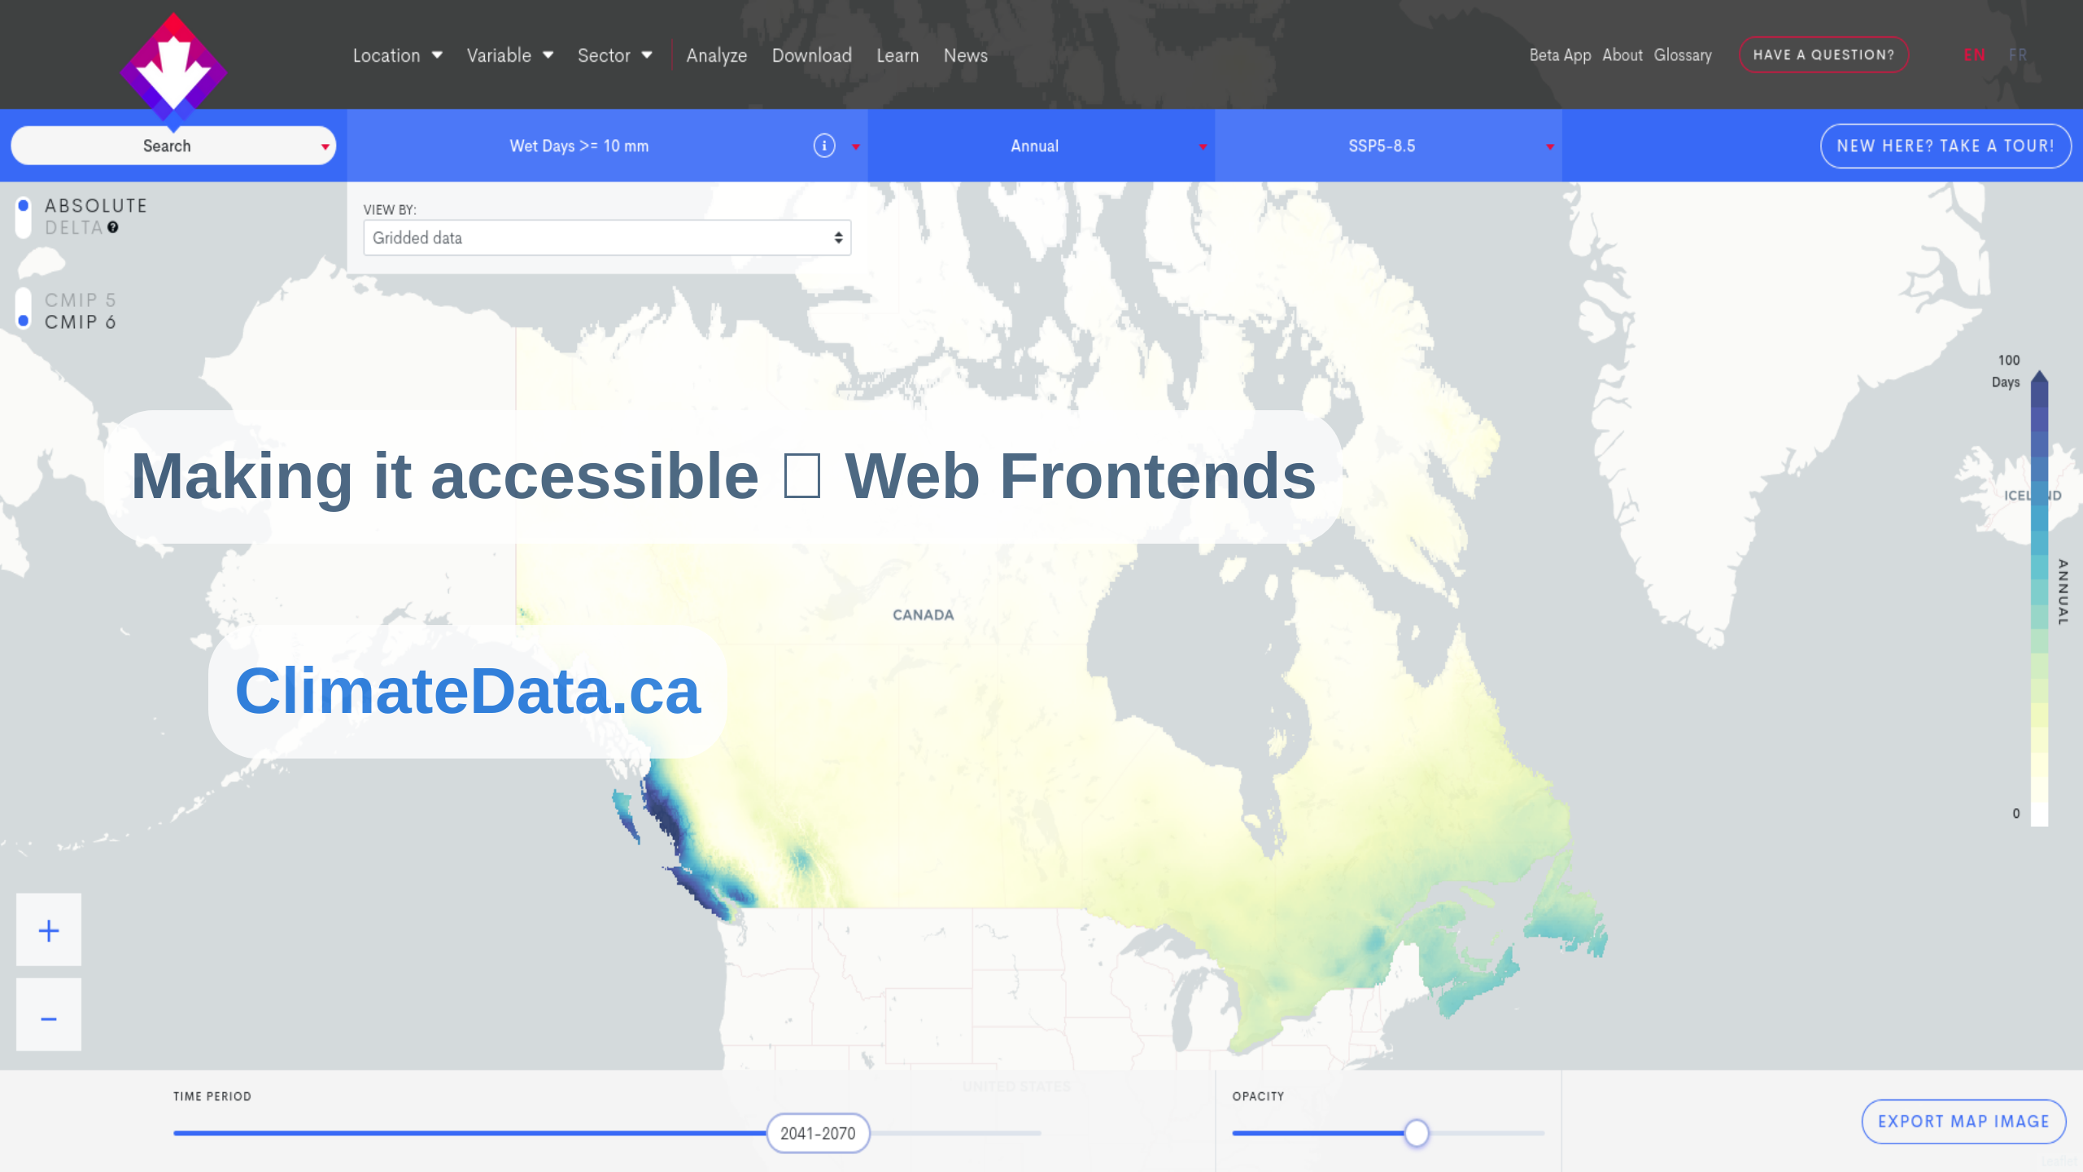

Slide 28
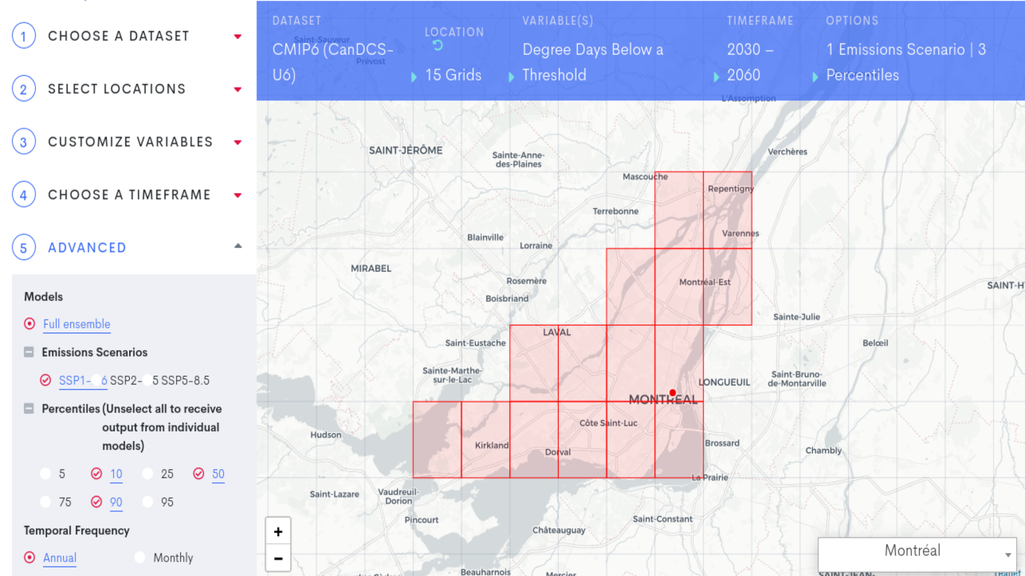

Slide 29
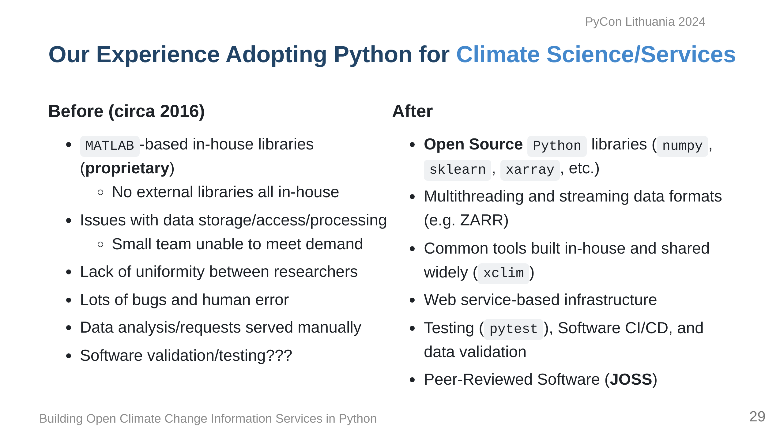

Slide 30
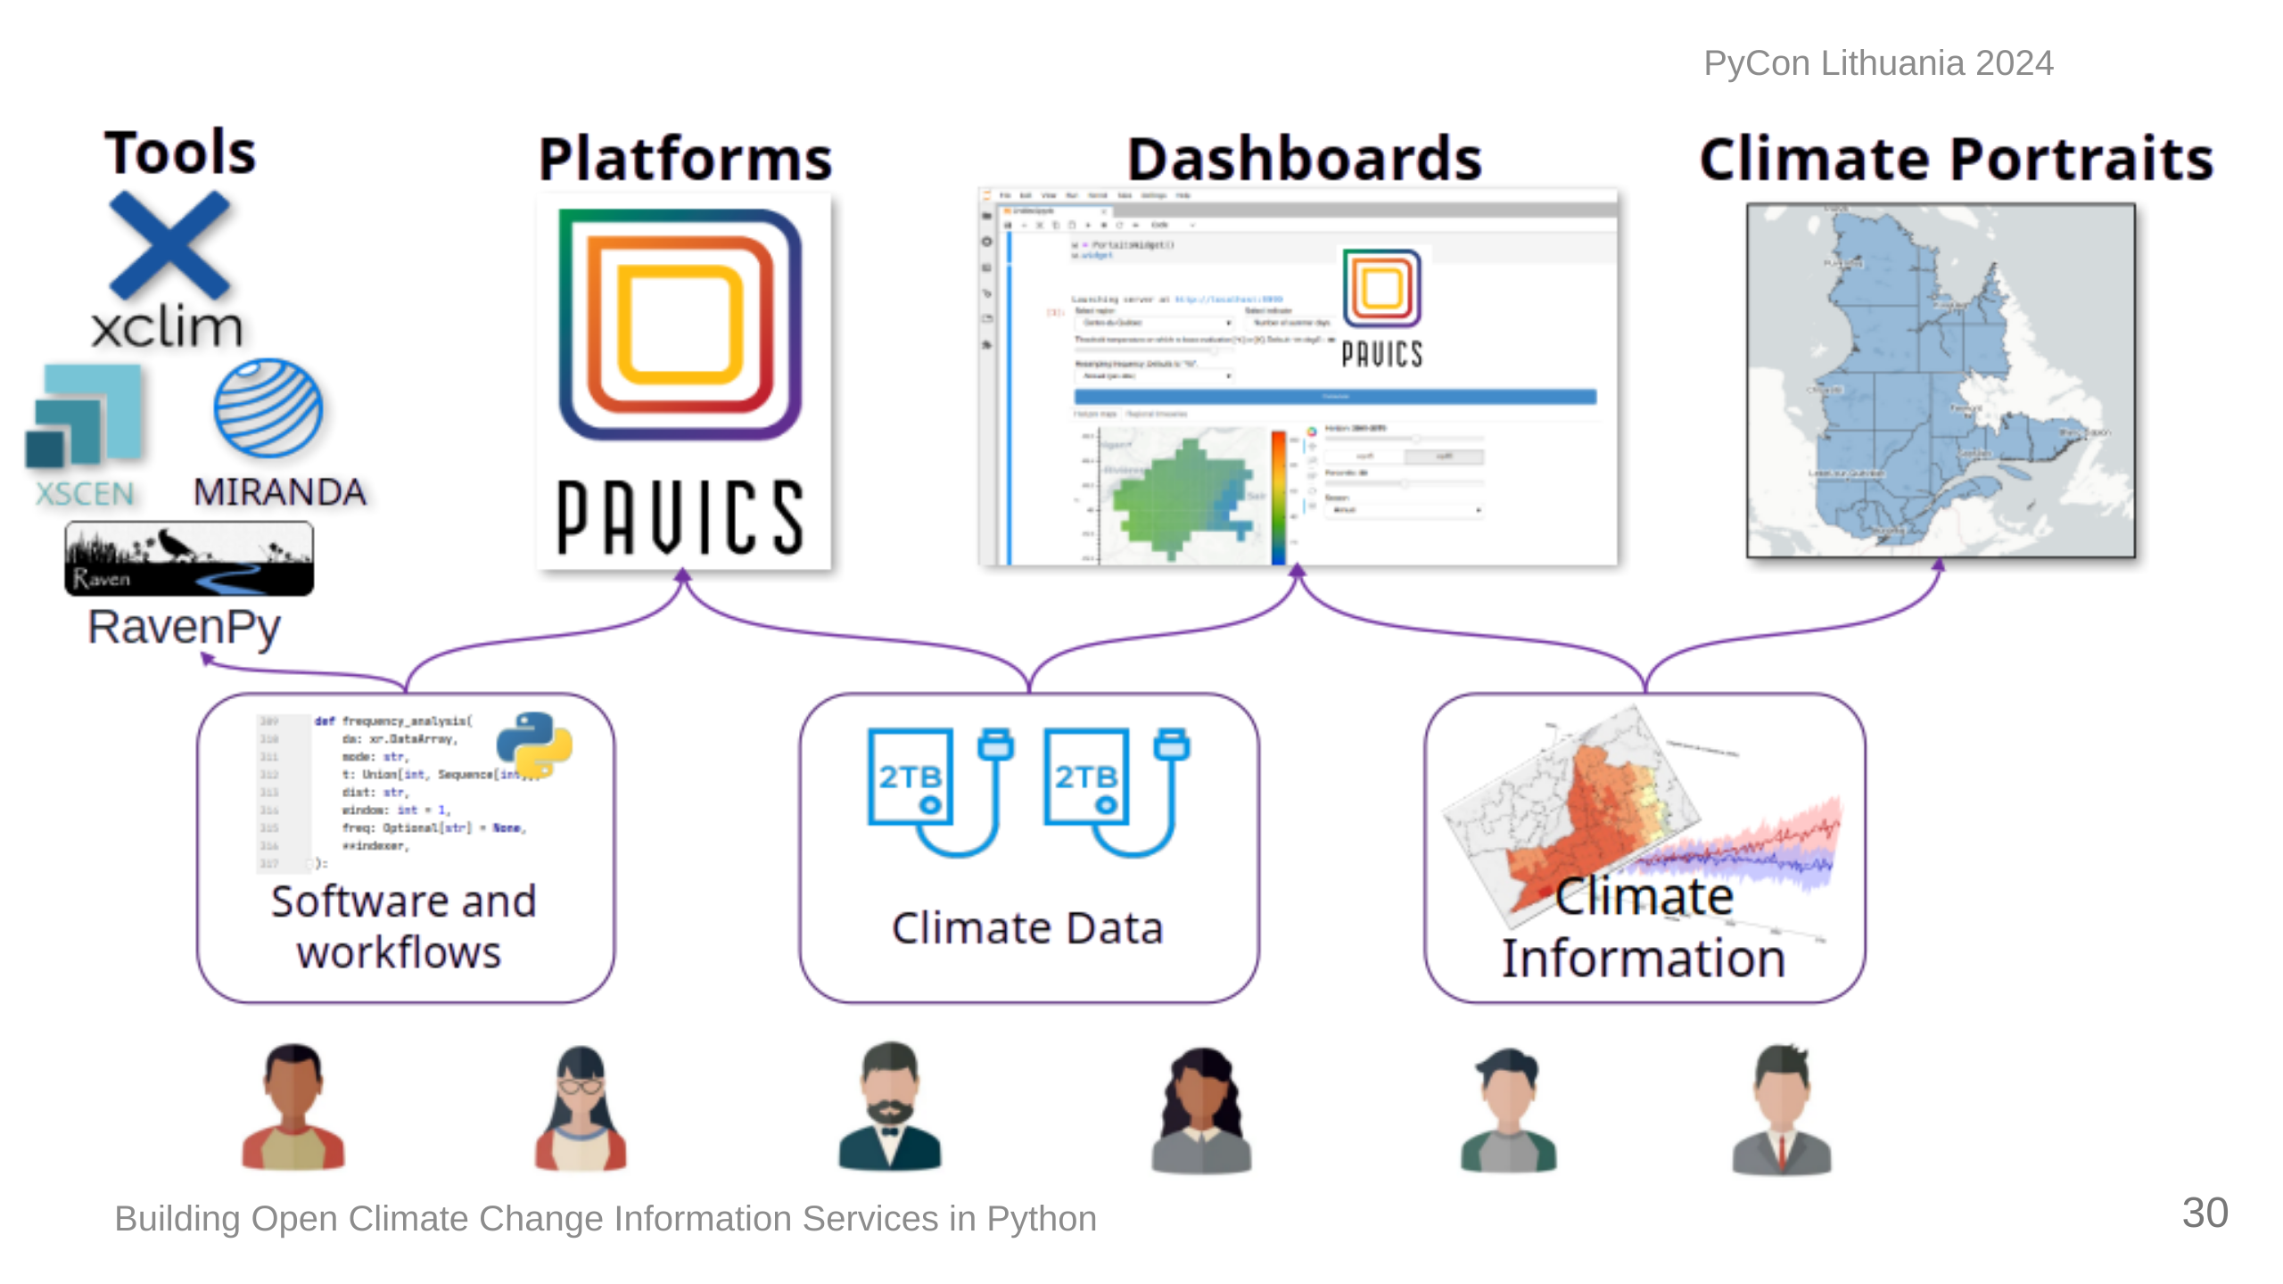

Slide 31
